Slide 1
Making a Living in Nuevo Santander: Rancheros & Vecinos
Armando C. Alonzo, Ph.D.
Texas A&M University
Historias Americanas
Edinburg, Texas
March 27, 2021

Slide 2
A. Brief Colonial Context: Hacer América
Evolution of New Spain, 1520s
The Eastern Corridor to Coahuila, Nuevo León, late 16th Century
Texas and the Seno Mexicano, late 17th and 18th centuries

Slide 3
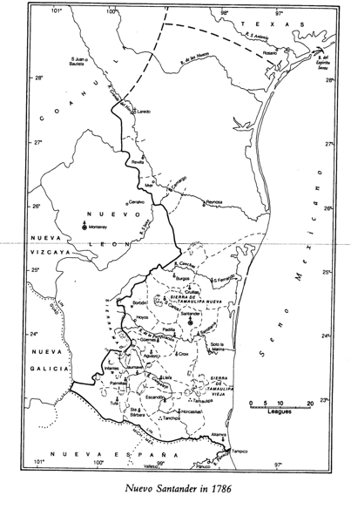

Slide 4
B. Motives for Colonization of La Colonia del Nuevo Santander
Imperial
Religious
Pobladores/Vecinos

Slide 5
C. The Initial Enterprise: The Escandón Era, 1747-1766: Initial Foundations
Town Settlements/las villas
Cabildo
Mission
Presidio
Ranchos & Haciendas
Mines

Slide 6
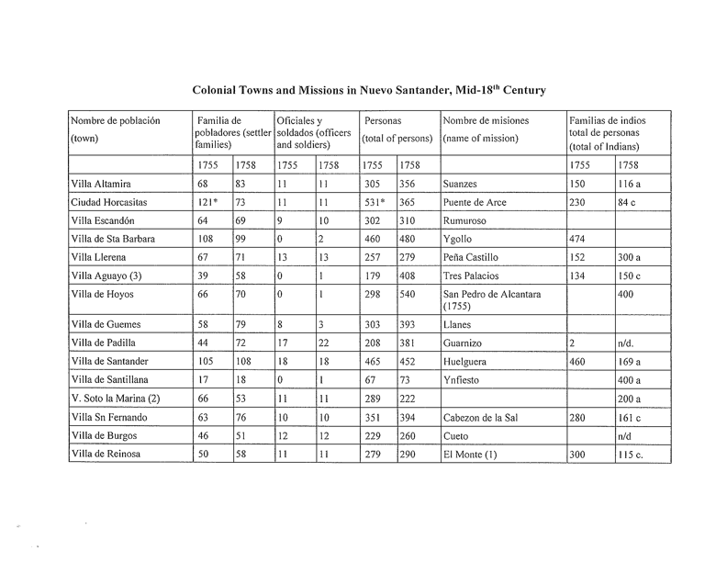

Slide 8
D. Diverse Society
Españoles
Mixed race/mestizos and others
Coahuiltecos/Native Americans
Significance

Slide 9
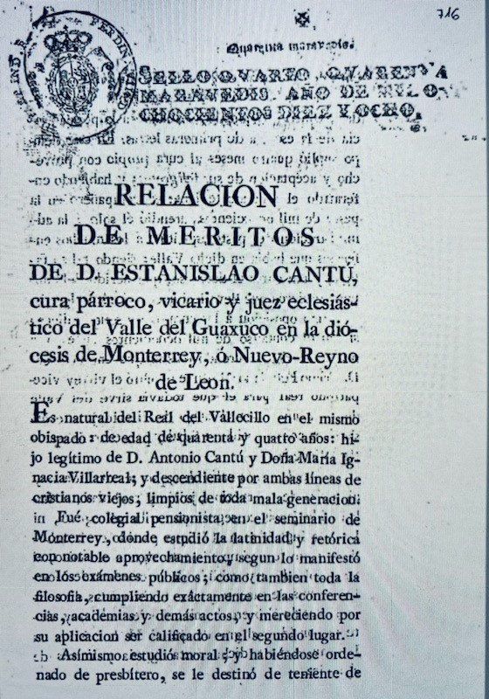

Slide 10
Document relating the merits of a parish priest for positions in the cathedral of Nuevo León
Relación de Méritos de D. Estanislao Cantú, parish priest, vicar and ecclesiastical judge of the Valley of Guaxuco in the diocese of Monterrey, or Nuevo Reyno de León.
This document is a summary of a secular priest’s background, his studies at the seminary of Monterrey, his ordination, the positions that he has held, his participation in (oposiciones) competitions for positions in the church, and his qualities. Testimonials were annexed to the document. Based on these points, he was considered by the dean and the cabildo of the cathedral of Monterrey in February 23, 1817 to be qualified for vacancies in the church in Nuevo León and all of America. All of this was presented to the secretary of the royal and supreme council and cámara (tribunal) of the Indies pertaining to New Spain, Madrid, 11.16.1818.

Slide 11
Villa de San Carlos

Slide 12
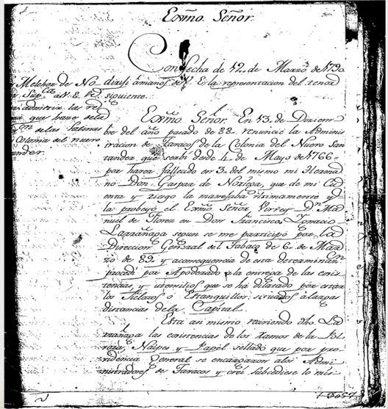
Letter of Melchor de Noriega to the Viceroy

Slide 13
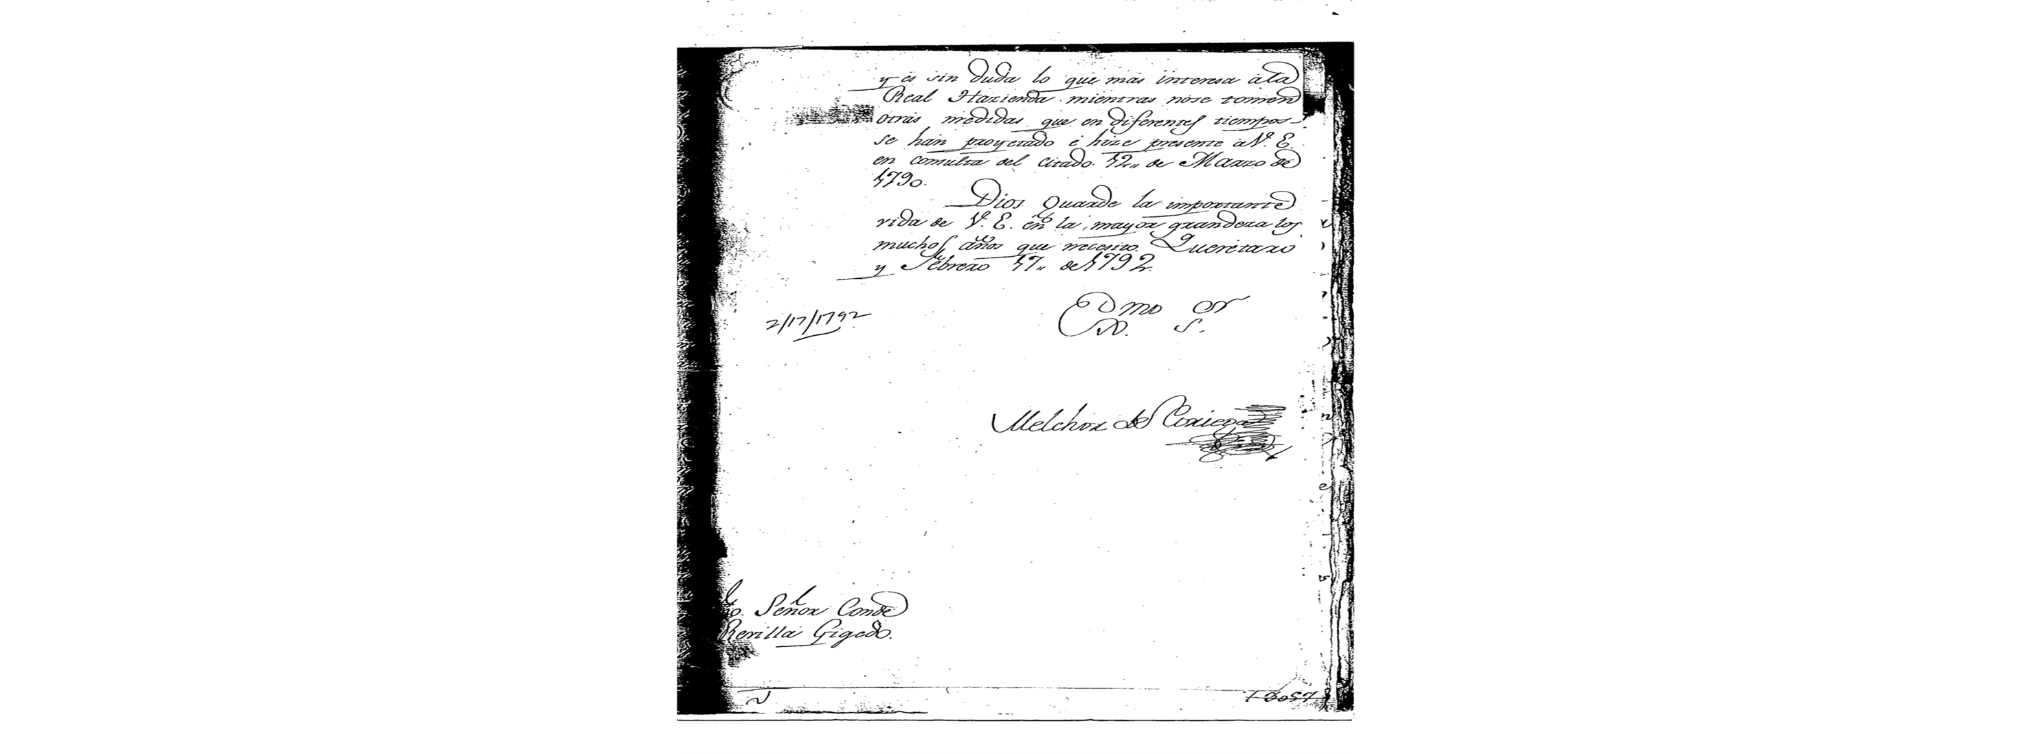

Slide 14
E. Post-Escandón, 1766-1824
Work of the Royal Commission to the Colony, 1766-’67
Granted land to settlers, towns & missions and demanded payment of taxes
Governor Escandón removed from office
Expansion of livestock production & markets
Limitations, including 1810 Revolution

Slide 15
F. Obtaining Spanish Land Grants
Denuncio de tierras de mercedes (claim)
Lengthy process to receive title (escritura)
North and northeast of Reynosa, and north and northeast of Camargo
As mining economy grew because of Bourbon reforms, so did ranching

Slide 16
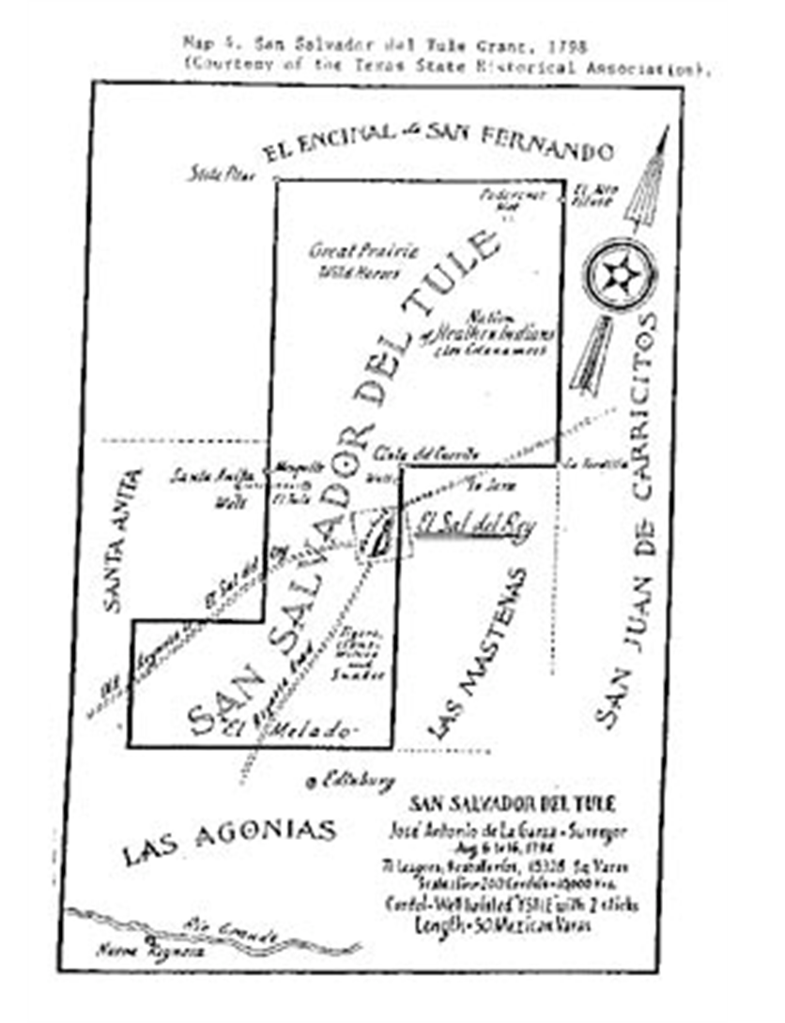

Slide 17
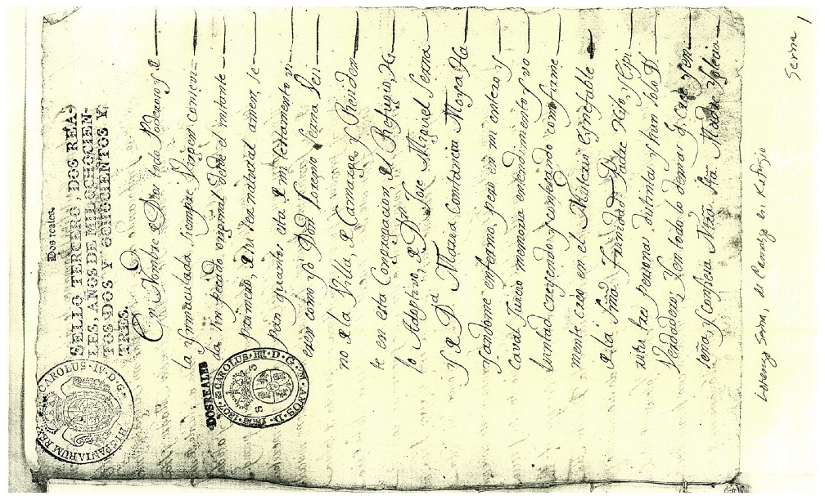

Slide 19
G. Ancillary Workers
Administrators and Mayordomos
Vaqueros and pastores (sirvientes)
Arrieros
Maestros albañiles and others

Slide 20
H. Taxes and Other Institutions
Diezmos, diezmeros
Alcabalas, receptores
Renta de tabaco, pólvora, naipes y sal/The Royal Monopoly on Tobacco, Gunpowder, Playing Cards, and Salt
Cabildo, presidio, missions

Slide 21
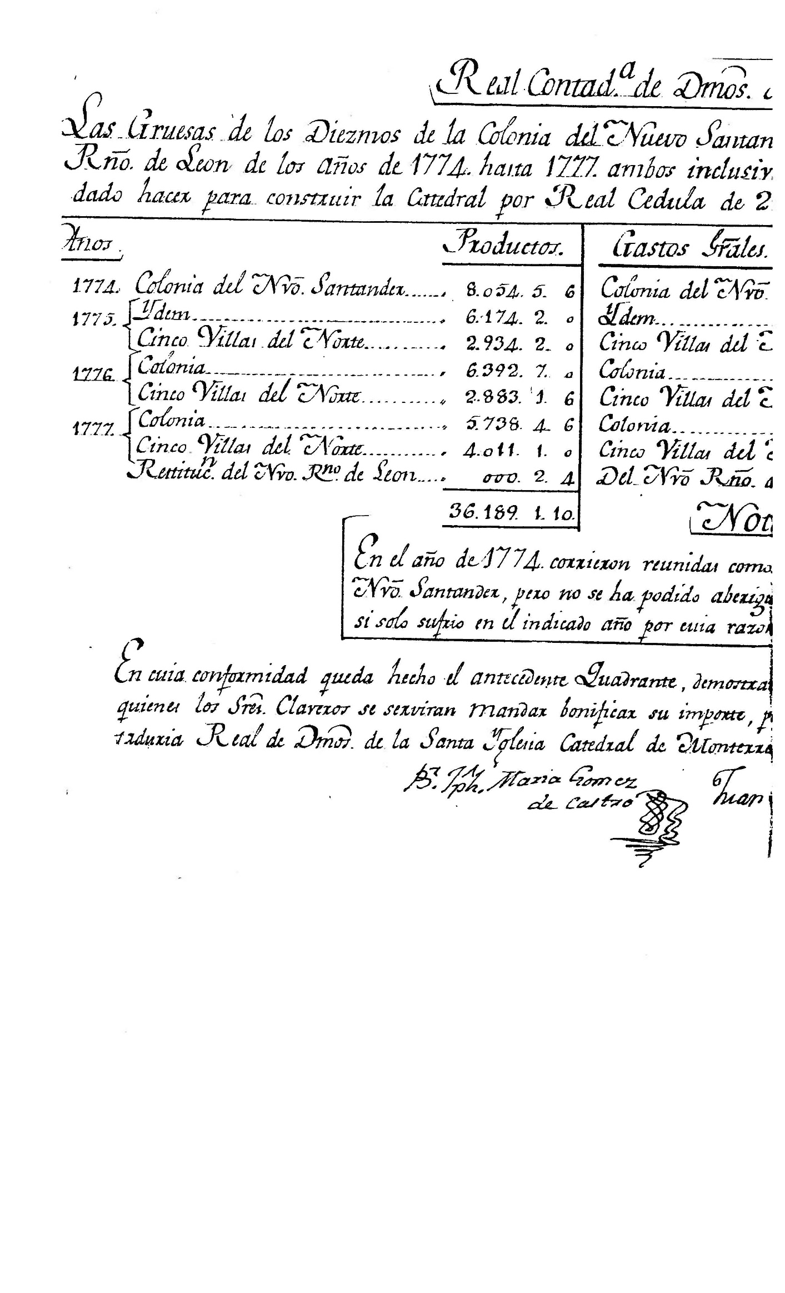

Slide 22
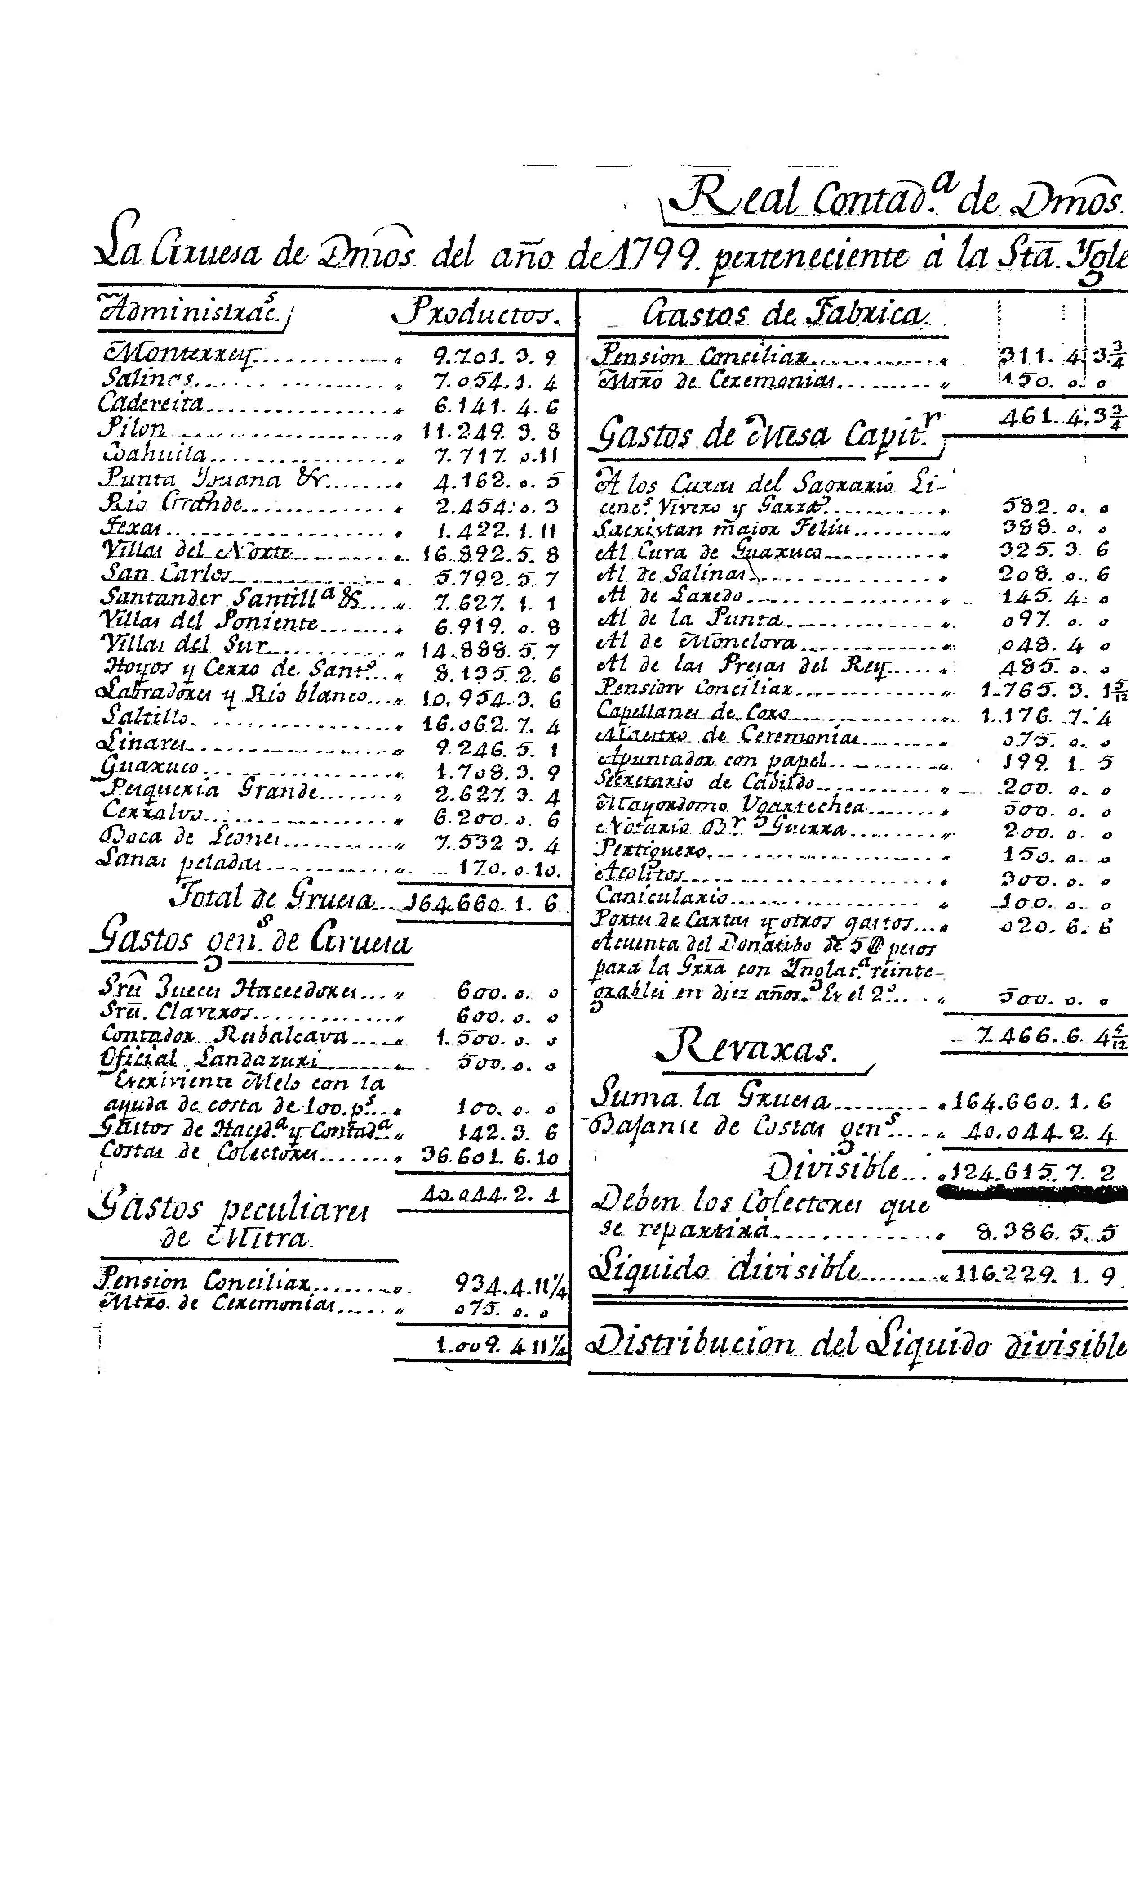

Slide 23
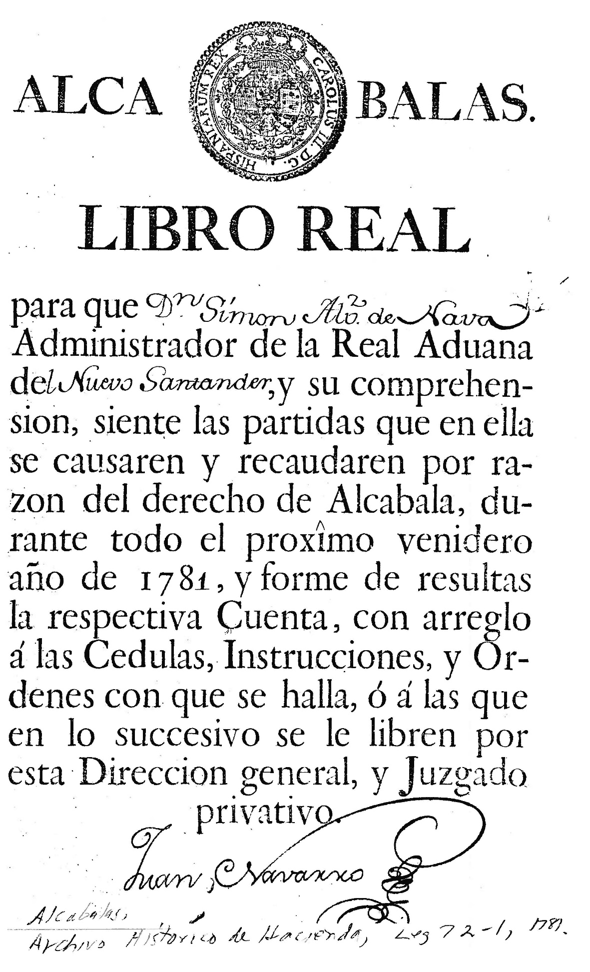

Slide 24
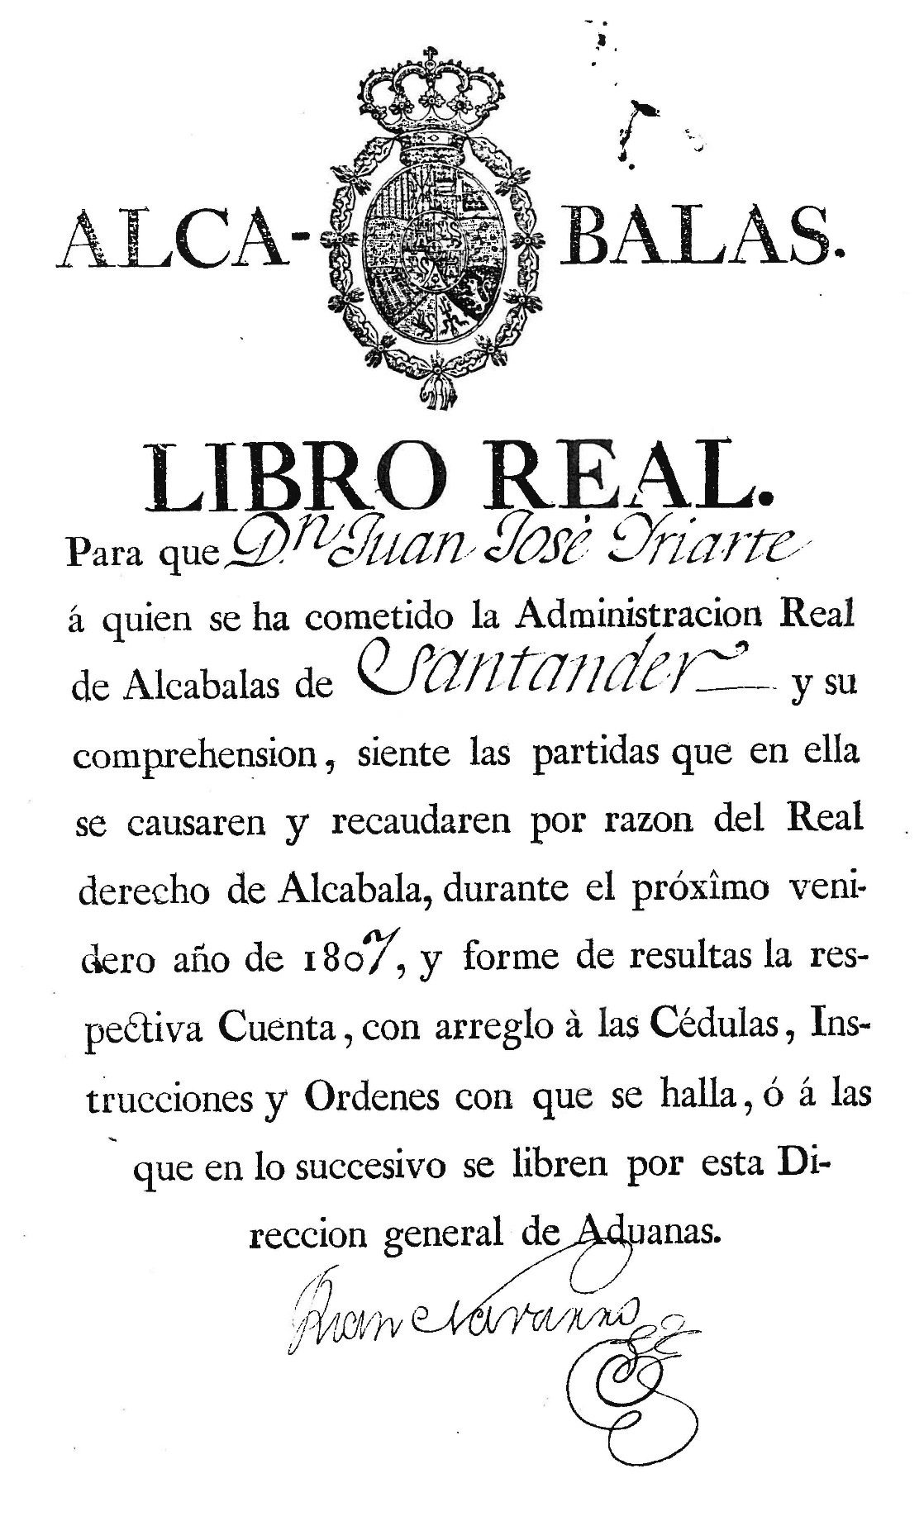

Slide 25
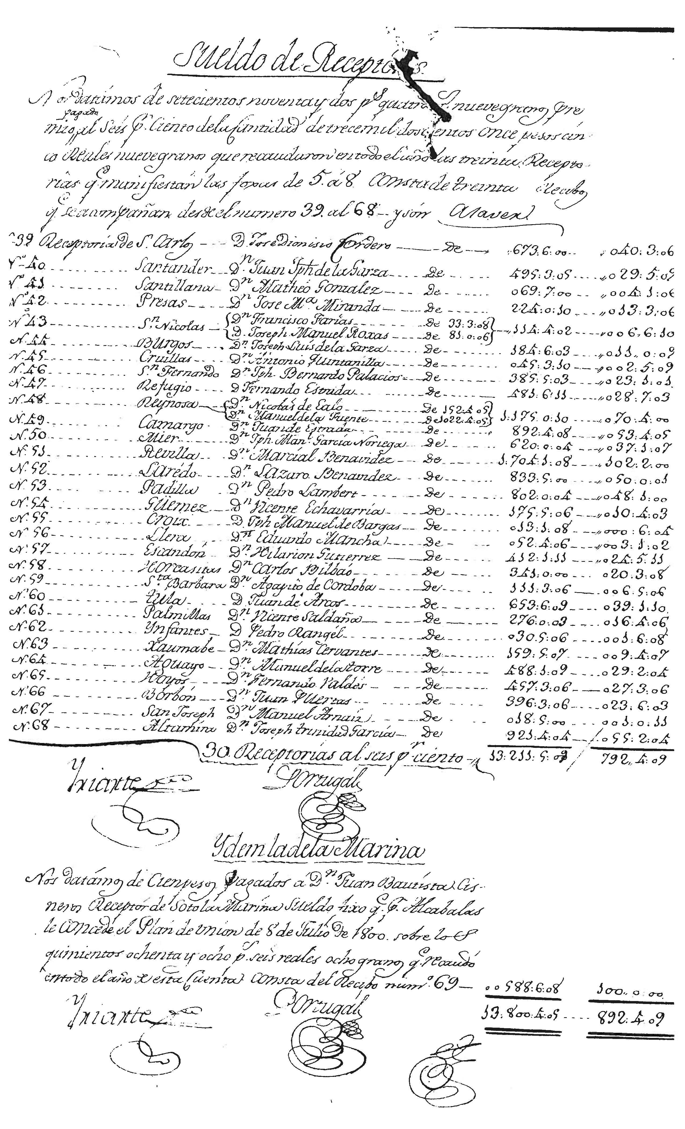

Slide 26
Notes on Sueldo de Receptores of Alcabalas
Payment to Receptors of the Alcabala Tax [for the year 1800 in Nuevo Santander]
A total of 732 pesos, 4 reales and 9 granos paid at 6 percent on a total of 13,211 pesos, 5 reales, and 9 granos collected in all of the 30 receptorias as shown in folios 5 to 8 with the receipts herein from no. 39 to 68, and they are as follows:
Left side is the receipt no. then the town, then the name of the receptor. The last two columns contain first the amount of sales tax collected by the agent of the receptoria, and it is followed by the 6 percent commission paid to the receptor.
Study the data and identify the villas del norte. For this data, Refugio is the original name for the villa of Matamoros.
Which two towns were most active in collection of the (alcabala) sales tax? At this time, which town was la reyna?
If the towns were grouped by districts, how important was the villas del norte? What additional information would we need to make such comparison?
Also, at the bottom of the page, there is one more entry. It states: Idem la de [Soto} la Marina. 100 pesos paid to Don Juan Bautista Cisneros, Receptor of Soto la Marina, the sueldo fixed under the Plan de Union of July 8, 1800 on the 588 pesos, 6 reales, and 8 granos that were collected in the entire year in this account being receipt no. 69.
Finally, note the two signatures on this document.

Slide 27
Significance
Implantation of Hispanic society and economy on the northern frontier of New Spain
Growth of a regional economy based largely on ranching, trade and commerce in products of the country
Rapid growth of diverse peoples

