Slide 1
Fall 2020 workshop November 7, 2020
Place-Based & Culturally Relevant pedagogies in an Online Platform

Slide 2
Treaty of Guadalupe Hidalgo 1848
After the culmination of the Mexican American War, the United States drafted a treaty in which peace was established between both nations. This document outlined a new U.S. border, stemming from the Rio Grande River and following a line in the sand towards the Pacific Ocean. Mexico was obliged to cede all lands north of this demarcation. For the people that resided on the former Mexican territory, now incorporated into American dominion, the plight of human rights was only just beginning.
The Treaty Of Guadalupe Hidalgo enshrined several clauses that assured unalienable rights and a new social classification to the new American citizens on the north bank of the river.
This pivotal document can be seen as the initial starting point of the Mexican American plight for civil rights.
Treaty of Guadalupe-Hidalgo[Exchange copy], February 2, 1848; Record Group 11; General Records of the United States Government, 1778-1992; National Archives.

Slide 3
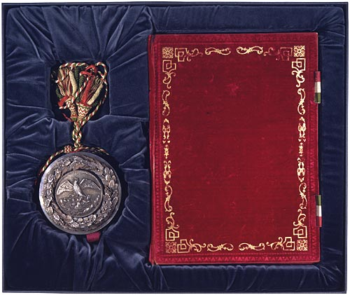
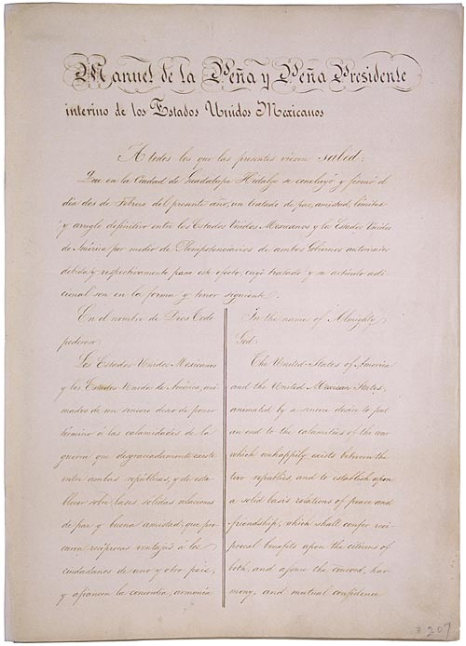
Images: Treaty of Guadalupe-Hidalgo [Exchange copy], February 2, 1848; Perfected Treaties, 1778-1945; Record Group 11; General Records of the United States Government, 1778-1992; National Archives.

Slide 4
Early civil rights in the Lower Rio Grande Valley 1900-1930

Slide 5
Social atmosphere regarding race

Slide 6
Ethnic and racial arena

Slide 7
Social segregation & discrimination was the catalyst for civil rights activism in South Texas. The following video is from the movie Giant & although it is not set in South Texas, this was common within the state. Giant was filmed in Marfa, TX & was released on November 24, 1956. Civil rights is a response to the way Mexican people were excluded in society & the conditions that Mexican Americans and other people of color faced.

Slide 8
Prominent members that changed the course of history
Picture, Alonso S. Perales with José de la Luz Sáenz in 1952. Perales is standing on the left. Both men were instrumental leaders for the League of United Latin American Citizens.
TSHA.
J.T. Canales, pictured within his own slide, was the third instrumental member to give rise to LULAC

Slide 9
J.T. Canales – Brownsville, TX
Source: https://www.youtube.com/watch?v=L5s5jiiNxgo

Slide 10
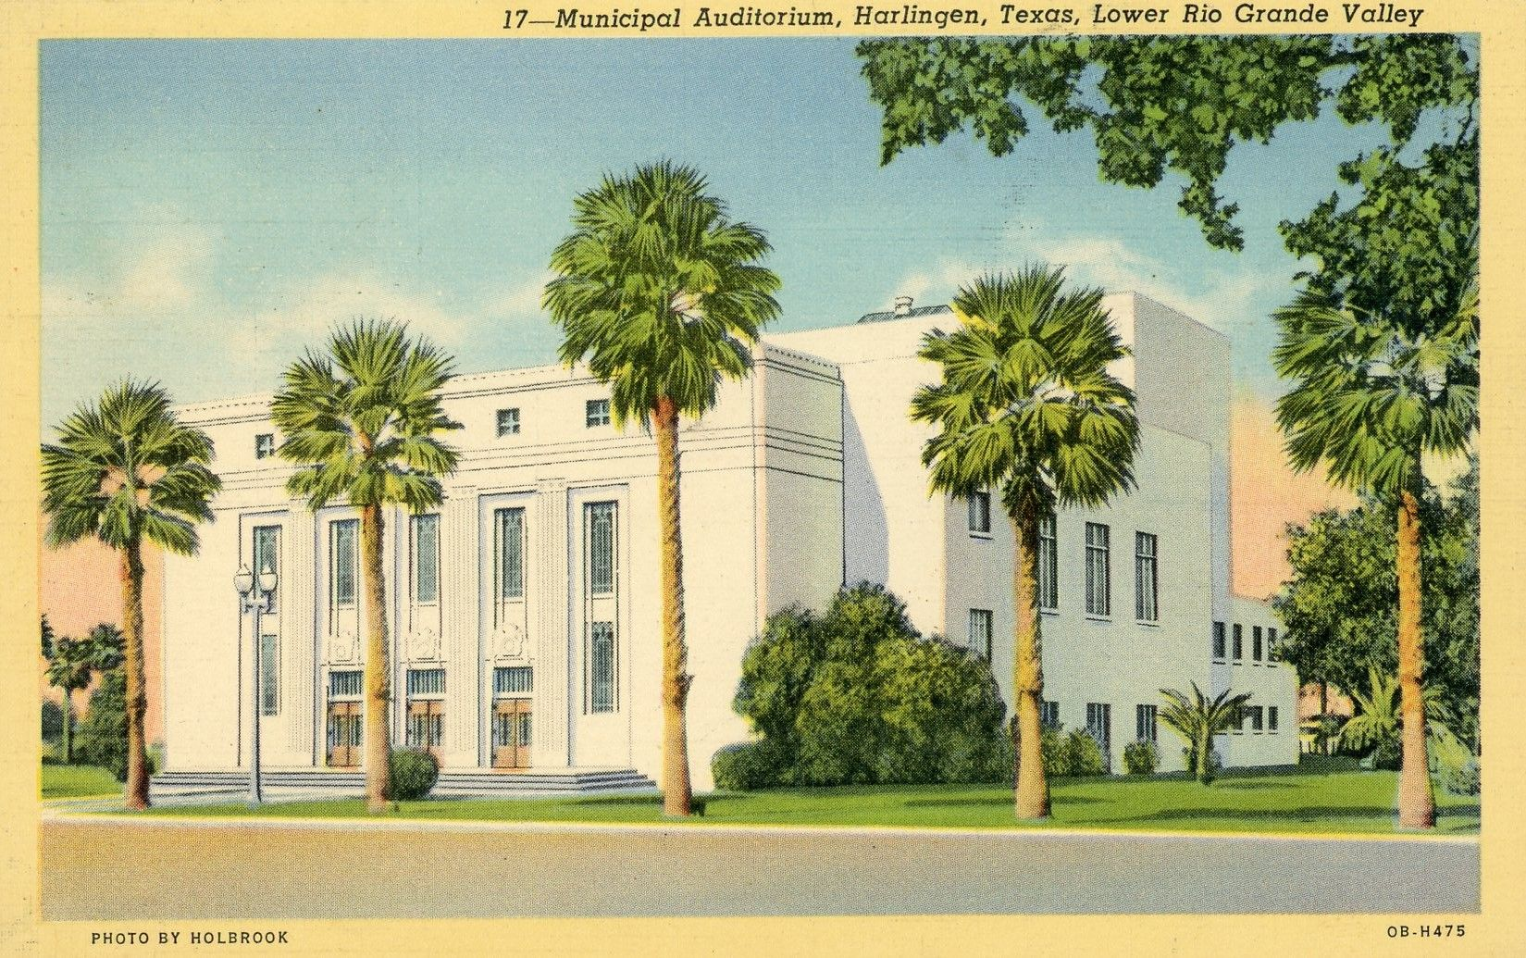
Harlingen Municipal Auditorium, Lulac convention, Harlingen, tX
The Harlingen Convention, a statewide political meeting called to discuss organizing against racial discrimination, was held at the Harlingen Auditorium on August 14, 1927. It was called by El Comité Provisional Organizador Pro-Raza, headed by Alonso S. Perales. Felipe Herrera of Harlingen acted as secretary. El Comité's membership consisted of Mexican Americans and Mexicans from Mercedes, Weslaco, Brownsville, Edinburg, Mission, San Benito, Donna, and Raymondville.
Cynthia E. Orozco, "Harlingen Convention," Handbook of Texas Online, accessed October 30, 2020, https://www.tshaonline.org/handbook/entries/harlingen-convention. Published by the Texas Historical Association.

Slide 11
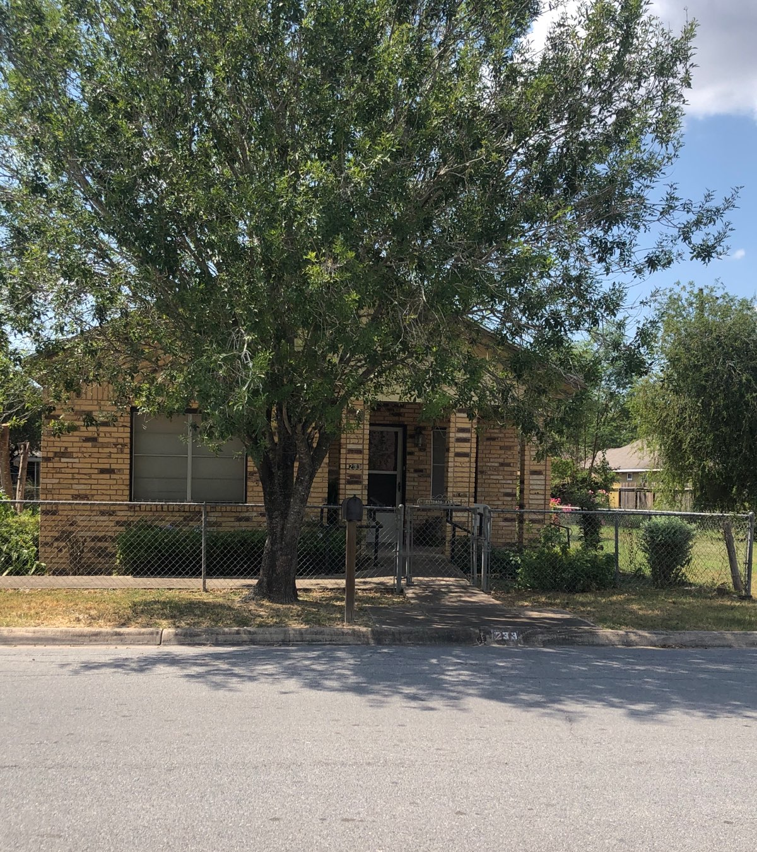
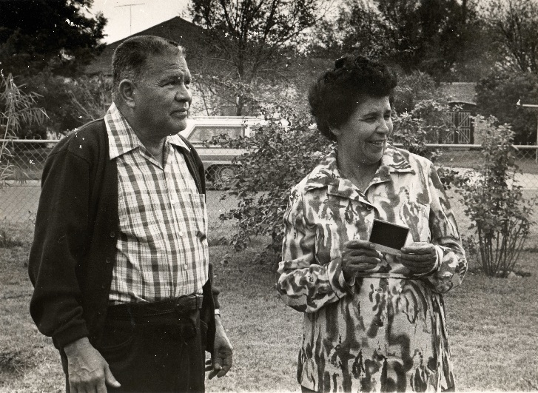
Aurora E. Orozco, Mercedes, TX
Home in Colorado St.
Photo credits: Elizabeth Silva & Dr. Cynthia E. Orozco

Slide 12
Aurora Estrada Orozco 1918-2011
A native of Cerralvo, Nuevo León, México, Aurora Estrada Orozco embodies the narrative of the countless Mexican American immigrants that arrive in the United States in pursuit of happiness. This outstanding woman overcame many obstacles laid at her feet for being of Hispanic descent. Her plight demonstrates the power of her actions as she gave rise to learned children, all the while attempting to overcome the racial, and social inequalities America upheld proudly.
Aurora's transfiguration molded her from the bonds of Mexican citizenry, into a treasured naturalized U.S. citizen, culminating in the prolific writings of a politically charged individual that infused her arduous past into her promising future.
Education, Religion and Politics were the very essence that motivated Aurora into fomenting change during an era in which people like her...did not merit it.

Slide 13
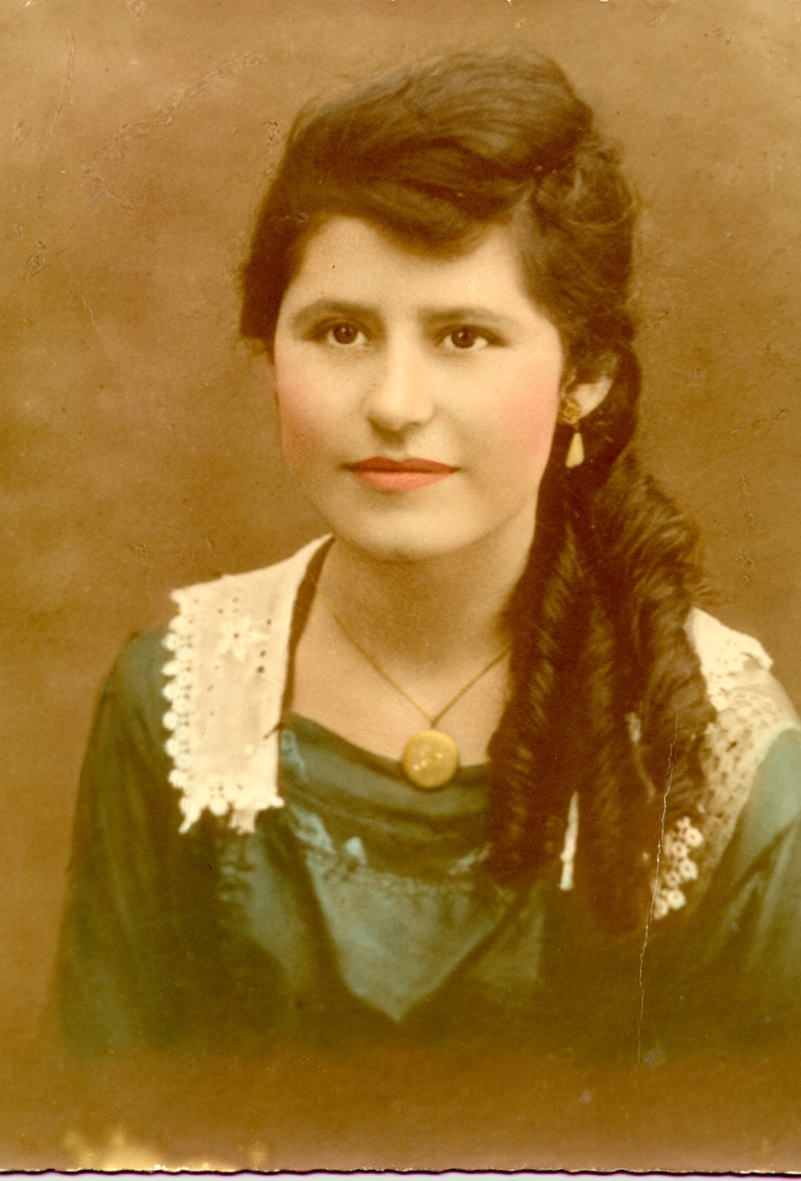
Adela sloss-vento,
Civil Rights Pioneer, Adela Sloss-Vento trailblazed the path for Mexican American enfranchisement within a discriminative American Anglo society.
Sloss-Vento formed part of the Pharr-San Juan High School Senior graduating class of 1927. Graduating as an American of Mexican heritage was a feat of the era.
Her arduous tenacity for politicizing her ideology over civil liberties was promulgated by media outlets, newspapers of the era such as La Prensa said of her efforts being "vigorous and well-documented defense of the Mexican people." Vento wrote extensively to political leaders within all levels of government. Countless letters circulated the legislative arena aiming for Mexican American civil liberties. Vento also featured in other papers, including Valley Morning Star, the Brownsville Herald and La Verdad.
Adela Sloss-Vento cofounded the "Ladies of LULAC" in the city of Alice in 1933, after women were allowed full membership status within LULAC.
Cynthia E. Orozco and Jazmin León, "Vento, Adela Sloss," Handbook of Texas Online, accessed November 02, 2020, https://www.tshaonline.org/handbook/entries/vento-adela-sloss. Published by the Texas State Historical Association.

Slide 14
Pharr San Juan High School - 1915
Pharr-San Juan-Alamo ISD / Homepage. Accessed November , 2020. https://www.psjaisd.us/.

Slide 15
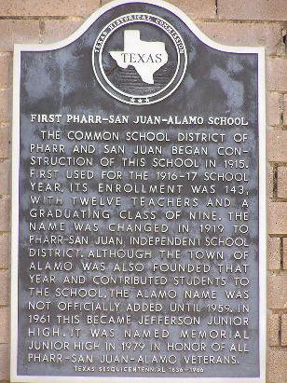
Pharr-San Juan High school - 1915
“The common school district of Pharr and San Juan began construction of this school in 1915. First used for the 1916-1917 school year, its enrollment was 143, with twelve teachers and a graduating class of nine. The name was changed in 1919 to Pharr-San Juan Independent School District. Although the town of Alamo was founded that year and contributed students to the school, the Alamo name was not officially added until 1959. In 1961 this became Jefferson Junior High. It was named Memorial Junior High in 1979 in honor of all Pharr-San Juan-Alamo veterans.”
"First Pharr-San Juan-Alamo School." Texas Historical Marker – First Pharr-San Juan-Alamo School. Accessed October 31, 2020 http://www.stxmaps.com/go/texas-historical-marker-first-pharr-san-juan-alamo-school.html.

Slide 16
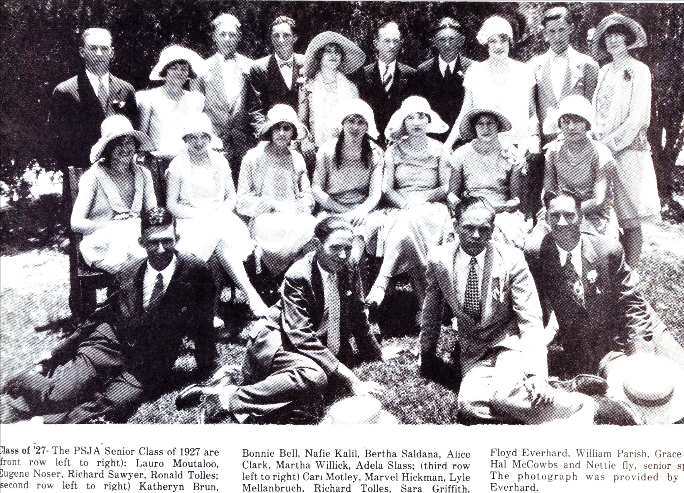
Pharr-San Juan Senior Class of 1927 Adela Sloss

Slide 17
Life and career
In 1935, Adela Sloss married Pedro C. Vento who fully supported her involvement in the Mexican American Civil Rights movement. During World War II, the couple lived in Corpus Christi, where Pedro Vento worked at the Corpus Christi Naval Air Station. Afterwards, they settled in Edinburg, Texas, where Pedro worked as a guard in the Hidalgo County jail and Adela served as the jail matron. They had two children, Irma Dora Vento and Arnoldo Vento.
After a life of public service and civic engagement, Adela Sloss-Vento died in Edinburg, Texas, on April 4, 1998.
Cynthia E. Orozco and Jazmin León, "Vento, Adela Sloss, "Handbook of Texas Online, accessed November 03, 2020. https://www.tshaonline.org/handbook/entries/vento-adela-sloss. Published by the Texas State Historical Association.

Slide 18
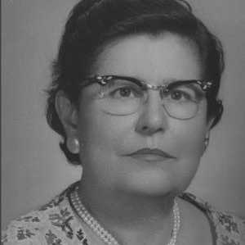
Mexican American “Agent of Change”
Orozco, Cynthia. "Pioneer Woman of Mexican American Civil Rights." Caller. Corpus Christi, November 14, 2017. https://www.caller.com/story/news/columnists/2017/11/14/pioneer-woman-mexican-american-civil-rights/864087001/.

