Slide 1
Perspectives on the Lower Rio Grande: Archaeology, Linguistics and Ethnohistory (Native American Settlement and Immigration on the Delta)
Martín Salinas Rivera

Slide 2
The Environs of the Lower Rio Bravo

Slide 3
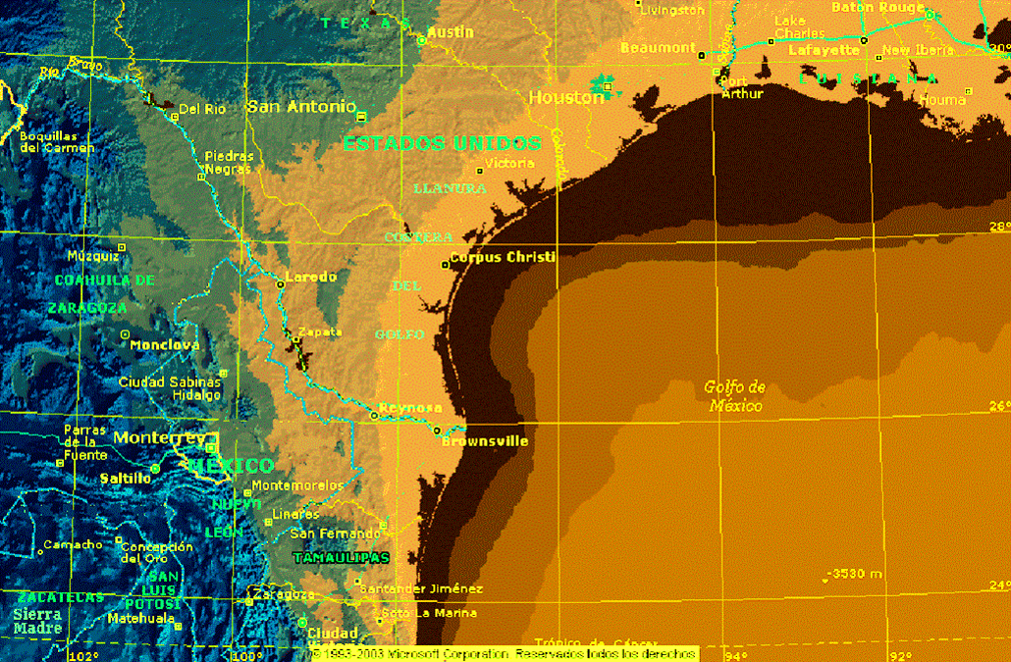

Slide 4
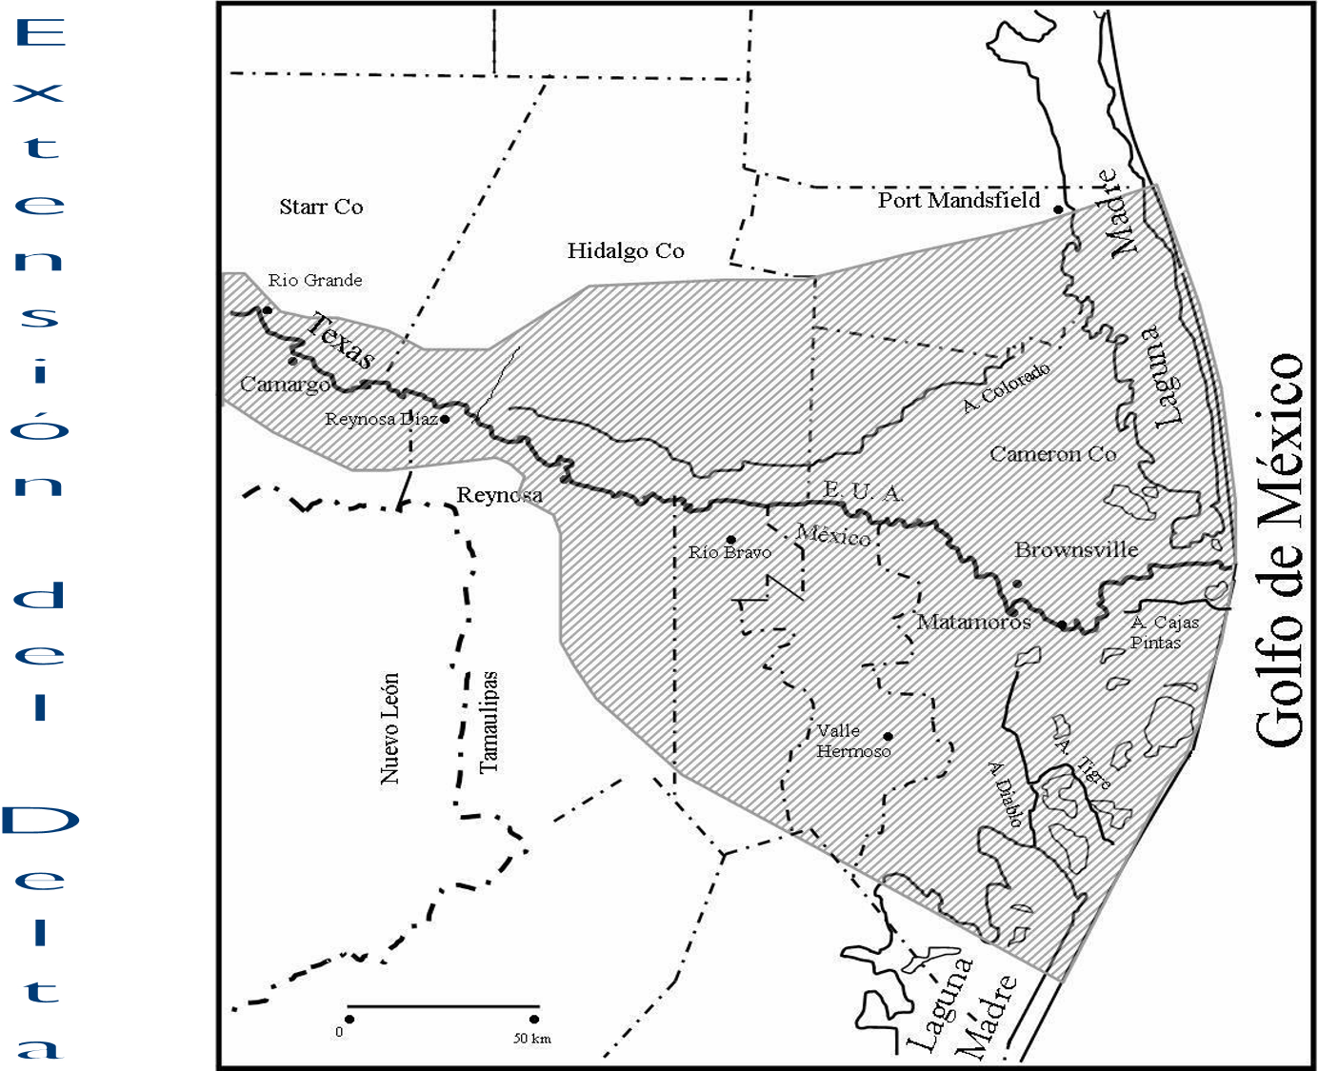
Expanse of the Delta
Gulf of Mexico

Slide 5
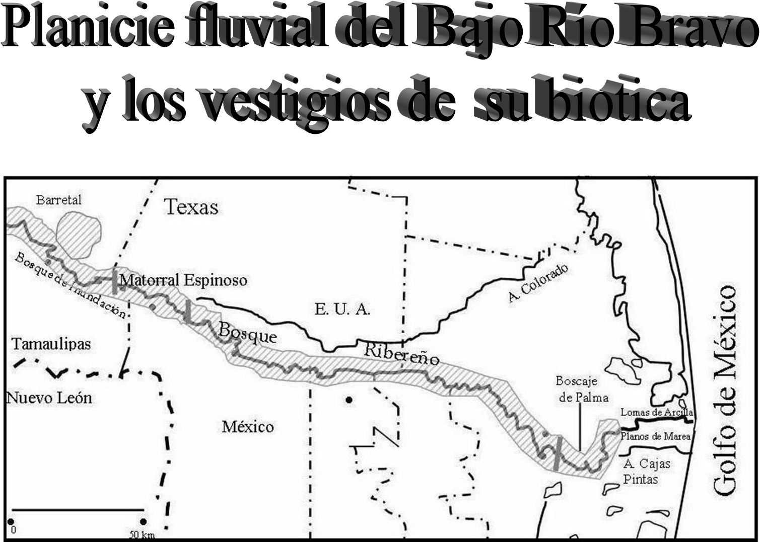
Gulf of Mexico
Floodplains of the Lower Rio Grande River and their biotic remnants

Slide 6
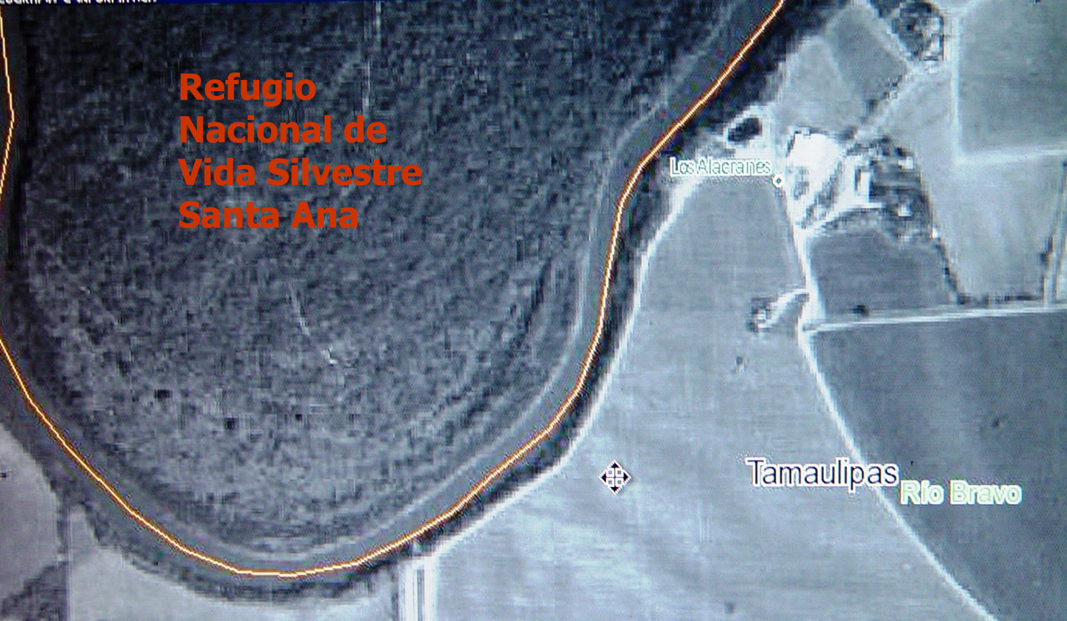
Santa Ana National Wildlife Refuge

Slide 7
Palm thicket
Sabal Palm Audubon Sanctuary
East of Brownsville

Slide 8
Tidal flat.
Remnants of the Brownsville-Barril complex

Slide 9
Clay dunes.
Remnants of the Brownsville-Barril complex

Slide 10
Trees of the Rio Grande Delta
According to botanical studies from the last two decades of the twentieth century, there are more than a thousand species of flowering plants in the delta. At least 28 of them are big enough to be considered trees as they grow above 10 ft. tall.
The following list has the most common used name for these trees and their taxonomic classification (gender, species and family).

Slide 11
Trees of the Rio Grande Delta
Anacahuita (xai’pawapel’)*: Cordia boissieri-Boraginaceae
Anacua: Ehretia anacua- Boraginaceae.
Brasil (xai’pamso’l)*: Condalia hookeri-Rhamnaceae.
Sapote (glepo’, pele’ pakai’)*: Diospyros texana-Ebenaceae.
Colima (pakwa’m, xai’sahueti’)*: Zanthoxylum fagara-Rutaceae.
Coma (kemo’)*: Bumelia celastrina-Sapotaceae.
Ebony (wa’-u)*: Pithecellobium ebano- Mimosoideae.
Live Oak (xai’ payauya’ap, payawe’t)*: Quercus virginiana-Fagaceae.
Mexican Ash: Fraxinum berlandieriana-Oleaceae.
Spiny Hackberry (glake’n, kua’s)*: Celtis ilida-Ulmaceae.
Guajillo Acacia: Acacia berlandieri-Mimosaceae.
Texas Guaicum (xai’ tom apela’pl’, xai’ tom apapa’kle)*: Guaiacum angustifolium-Zygophyllaceae
Huisache: Acacia farmesiana- Mimosoideae.
Soapberry: Sapindus drummondii-Sapindaceae.
Jopoy: Esenbeckia Runyonnii-Rutaceae.
Mesquite (ta’n)*: Prosopis glandulosa, Mimosoideae.
Mountain Laurel: Sophora secundiflora-Fabaceae.
Elm: Ulmus crassifolia-Ulmaceae.
Palm Tree: Sabal mexicana-Arecaceae (Palmaceae).
Sugar Hackberry: Ceitis laevigata-Ulmaceae.
Texas Paloverde: Cercidium Texanum-Caesalpiniaceae.
Jerusalme Thorn (xai’ payalu’i)*: Parkinsonia aculeata-Caesalpiniaceae
Montezuma Bald Cypress: Taxodium muconatum-Taxodiaceae.
Coyote Willow: Salix exigua-Salicaceae.
Black Willow (sepiauya’m)*: Salix nigra- Salicaceae.
Tenaza: Pithecellobium pallens- Mimosoideae.
Tepeguaje: Leucaena iveruienta- Mimosoideae.
Wright Acacia (xai’ pakassa’p)*: Acacia wrightii- Mimosoideae.
Common name and scientific name (gender, species, family)
Name in Comecrudo language, used by indigenous people that lived in the Rio Grande.

Slide 12
Native Settlements in the Delta: An Archeological Perspective

Slide 13
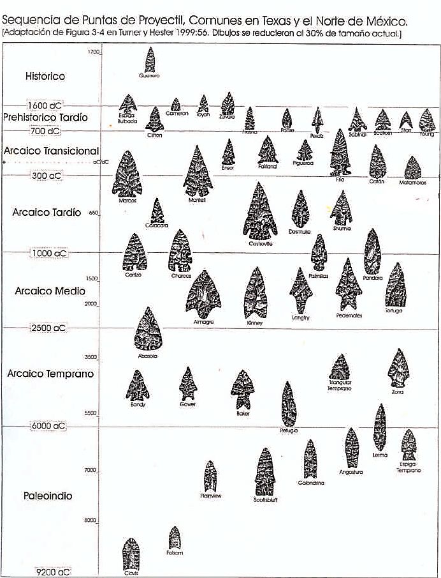
Projectile point timeline, common in Texas and Northern Mexico
[Taken from Figure 3-4 in Turner and Hester 1999;56. Drawings were reduced by 30% from the actual size.]
Historic
Late Prehistoric
Transitional Archaic
Late Archaic
Middle Archaic
Early Archaic
Paleoindian

Slide 14
Projectile Points of the early Paleoindian age
Falcon Dam,
Tamaulipas-Texas,
Clovis (A-E) and Folsom (F)

Slide 15
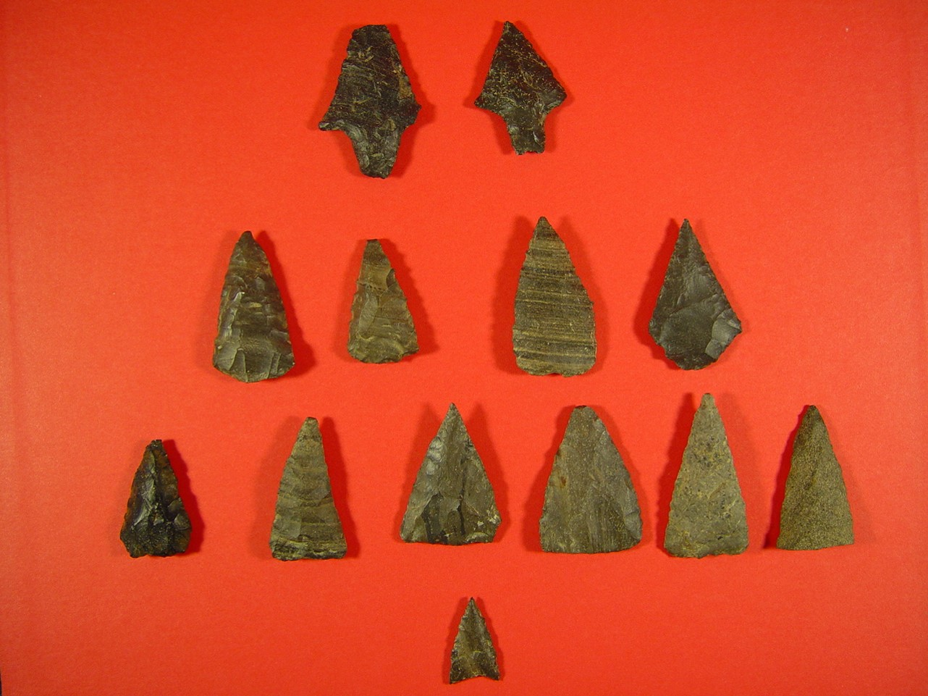

Slide 16
Atlatl, or Spear Thrower
The spear thrower uses the centrifuge force that pushes an object away from its center of rotation. This was used as a hunting tool since 9200 bC. In some parts of Texas, the atlatl was still used up until a few centuries before Spanish conquest. (Turner y Hester 1999:6,Fig.1-2)
a. Atlatl - Spear Thrower
b. Handling of an atlatl
c. Spear holder
d. Spear holder inserted into shaft

Slide 17
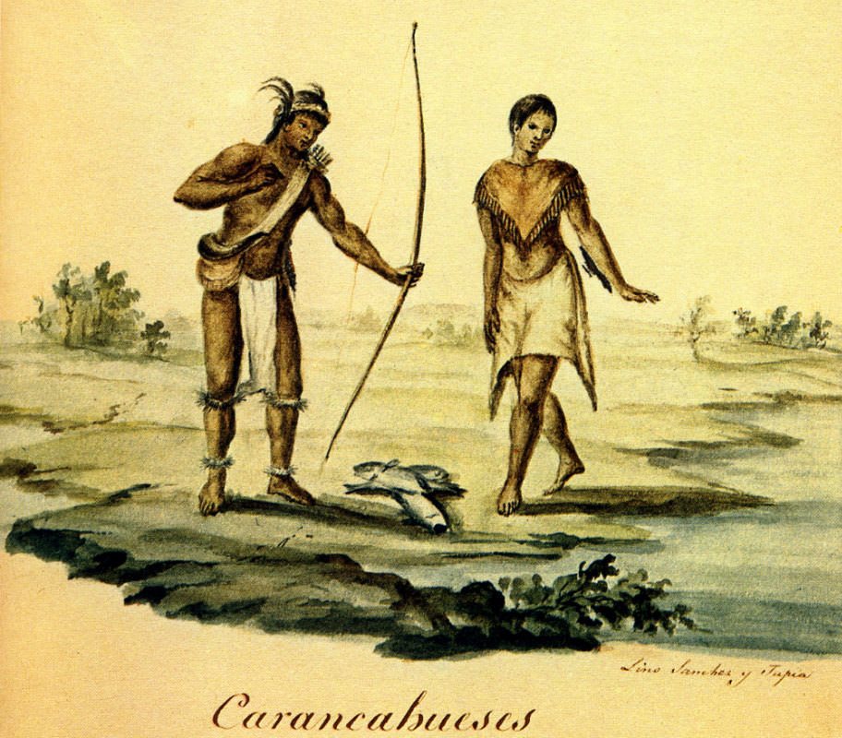

Slide 18
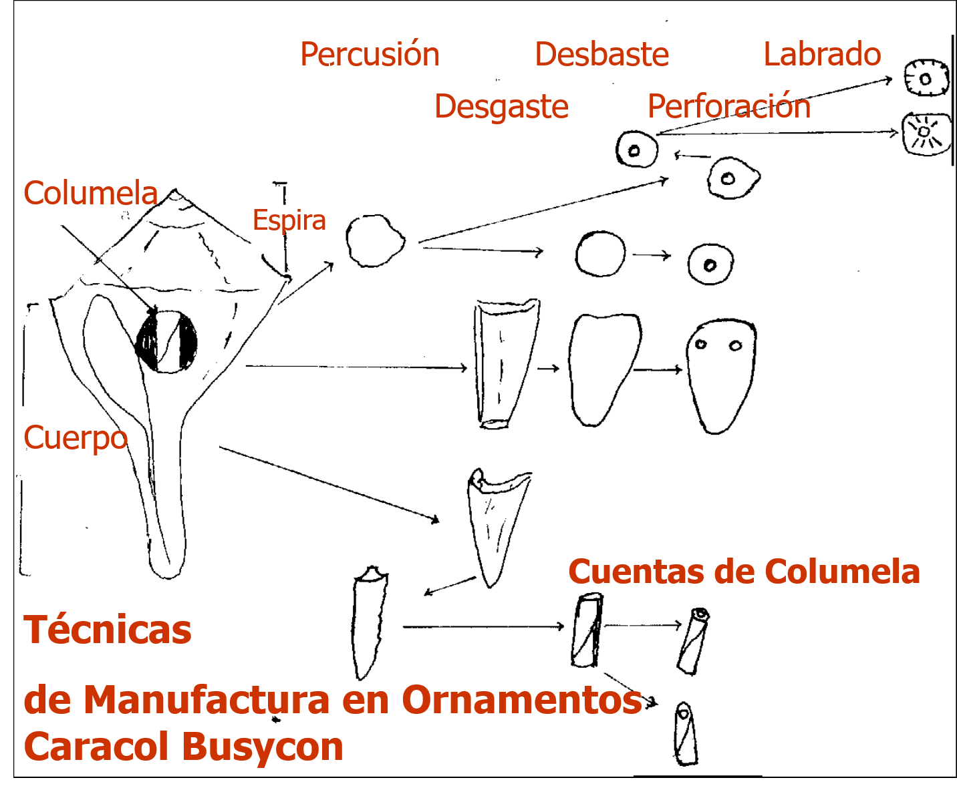
Percussion
Grinding
Carving
Shell
Polishing
Perforation
Spire
Body
Columela Beads
Manufacturing techniques in Busycon Snail Ornaments

Slide 19
Columela Pendants and Beads of Busycon Snail, Rattles and Olive Snail.
Brownsville-Barril Complex

Slide 20
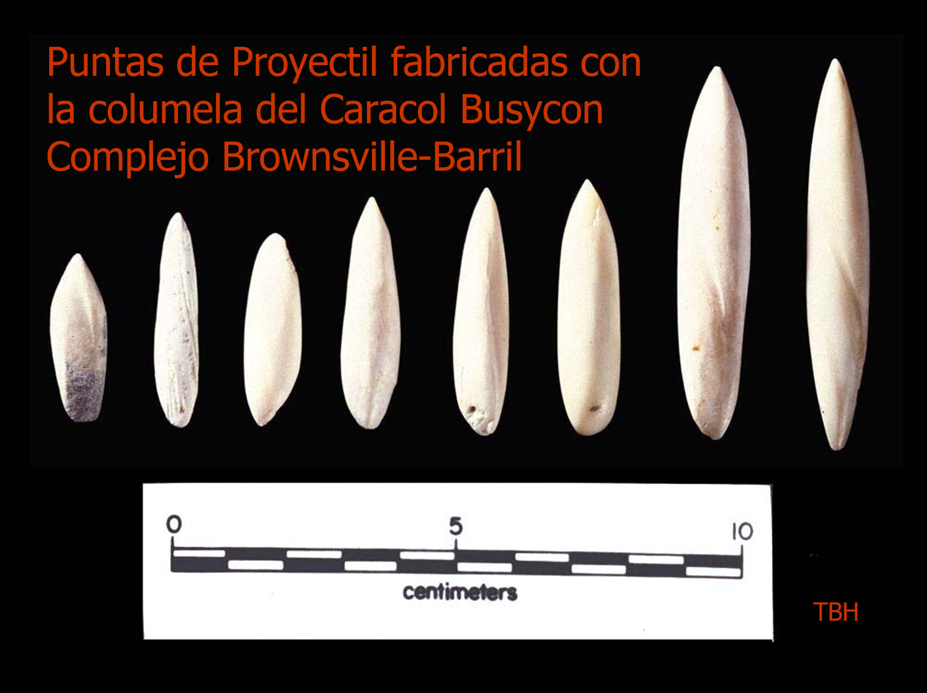
Projecticle points made with Columela from the Busycon snail. Brownsville-Barril Complex

Slide 21
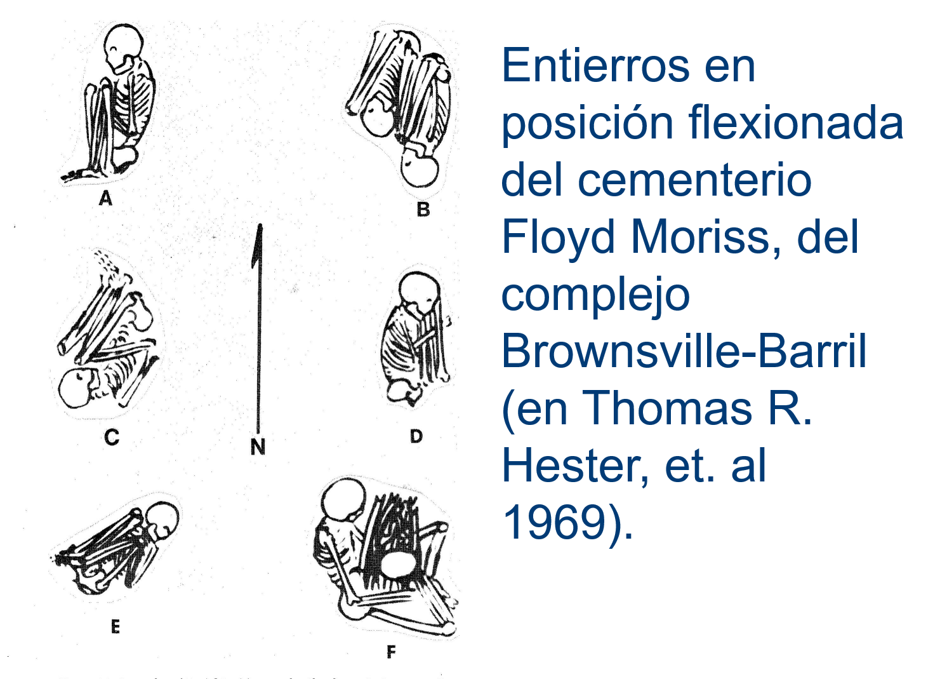
Burials in flexed position. Floyd Morris Cementery,
Brownsville-Barril Complex (Thomas R. Hester, et. Al 1969)

Slide 22
LINGUSITICS
IN THE COASTAL PLAINS

Slide 23
Table 5
DIFFERENT ETHNIC GROUP NAMES FROM THE MAIN COAST IN TEXAS RELATED TO THE KARANKAWA
Groups found by castaways in the expedition led by
Pánfilo de Narváez, 1528 - 1535:
Capoques
Hans
Charrucos
Deguenes
Quevene
Guaycones
Quitole
Camoles
Gente de los Higos

Slide 24
Table 5 cont.
Groups related with Fort San Luís de la Salle, 1685-1689:
Quaras o kouraras
Kouans o quouan
Korenkake o koínkahe
Bahamos o bracamos
Quinets
Quoaquis
Karankawa groups from the 18th century and part of the 19th century:
Capoques ( Caoque o Cocos)
Cujanes (Cox anes, Cujanos)
Karankawa (Caranncaguases, Talancague)
Coapites,(Guapites)
Copanos (Coopanes, Cobanes).

Slide 25
Ethnohistory

Slide 26
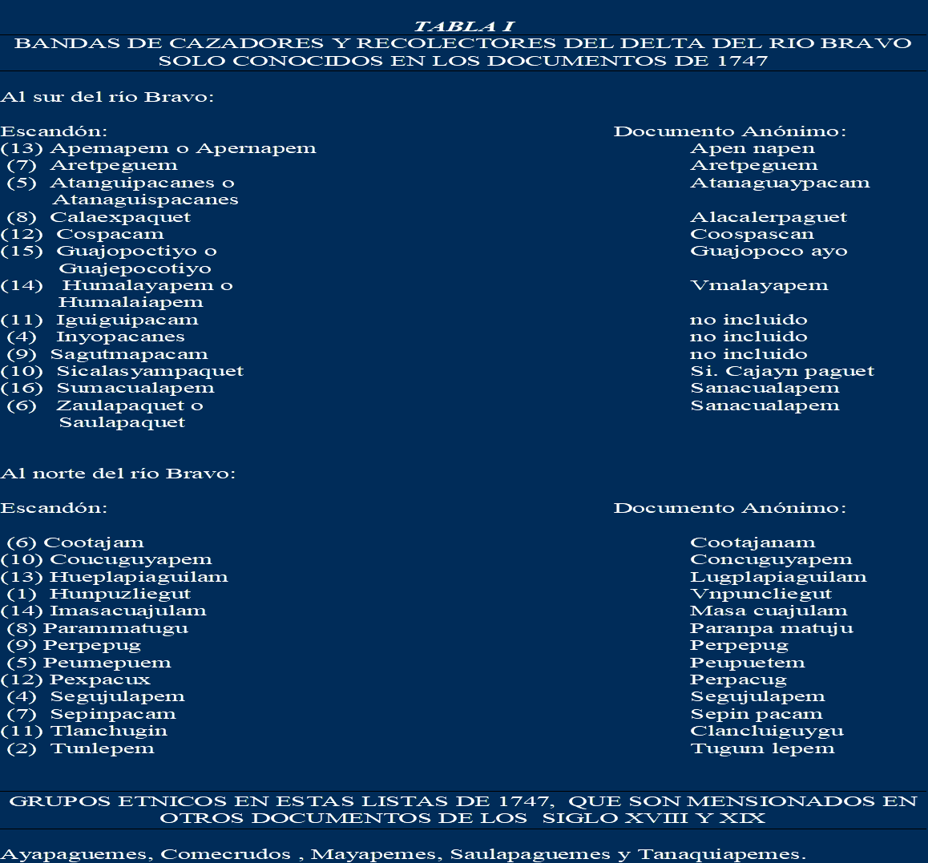
GROUPS OF HUNTER-GATHERERS IN THE RIO GRANDE DELTA, KNOWN ONLY FROM 1747 DOCUMENTS
South of the Rio Grande
According to Escandón
According to anonymous document
North of the Rio Grande
According to Escandón
According to anonymous document
ETHNIC GROUPS FROM THESE LISTS ALSO MENTIONED IN OTHER DOCUMENTSFROM THE 18TH AND 19TH CENTURIES

Slide 27
Ethnic group population size in the Western side of old Reynosa, 1790
RESIDENTS

Slide 28
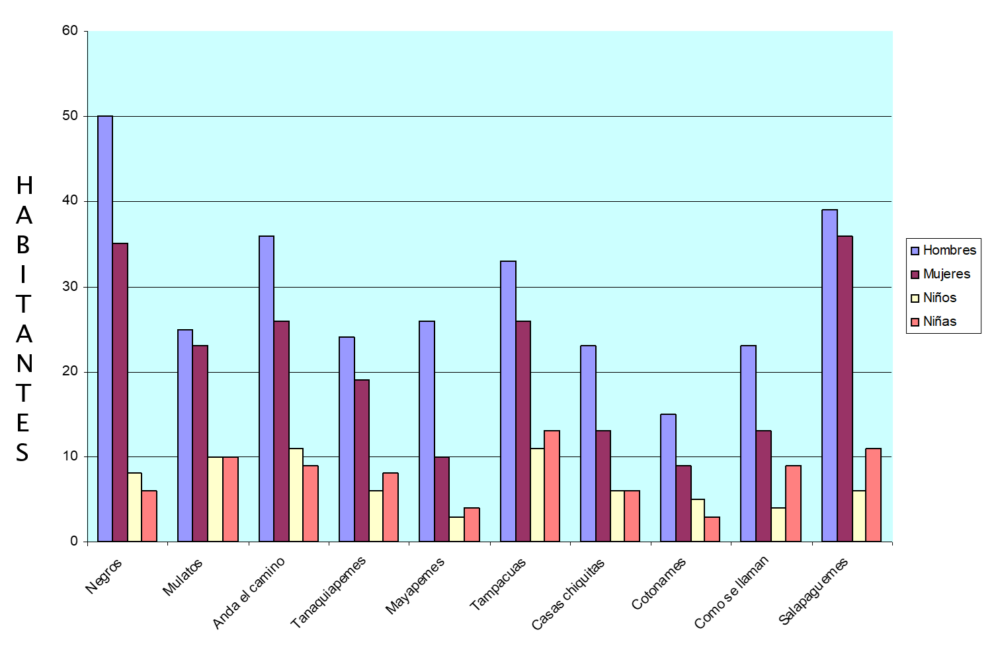
POPULATION
Men
Women
Boys
Girls

Slide 29
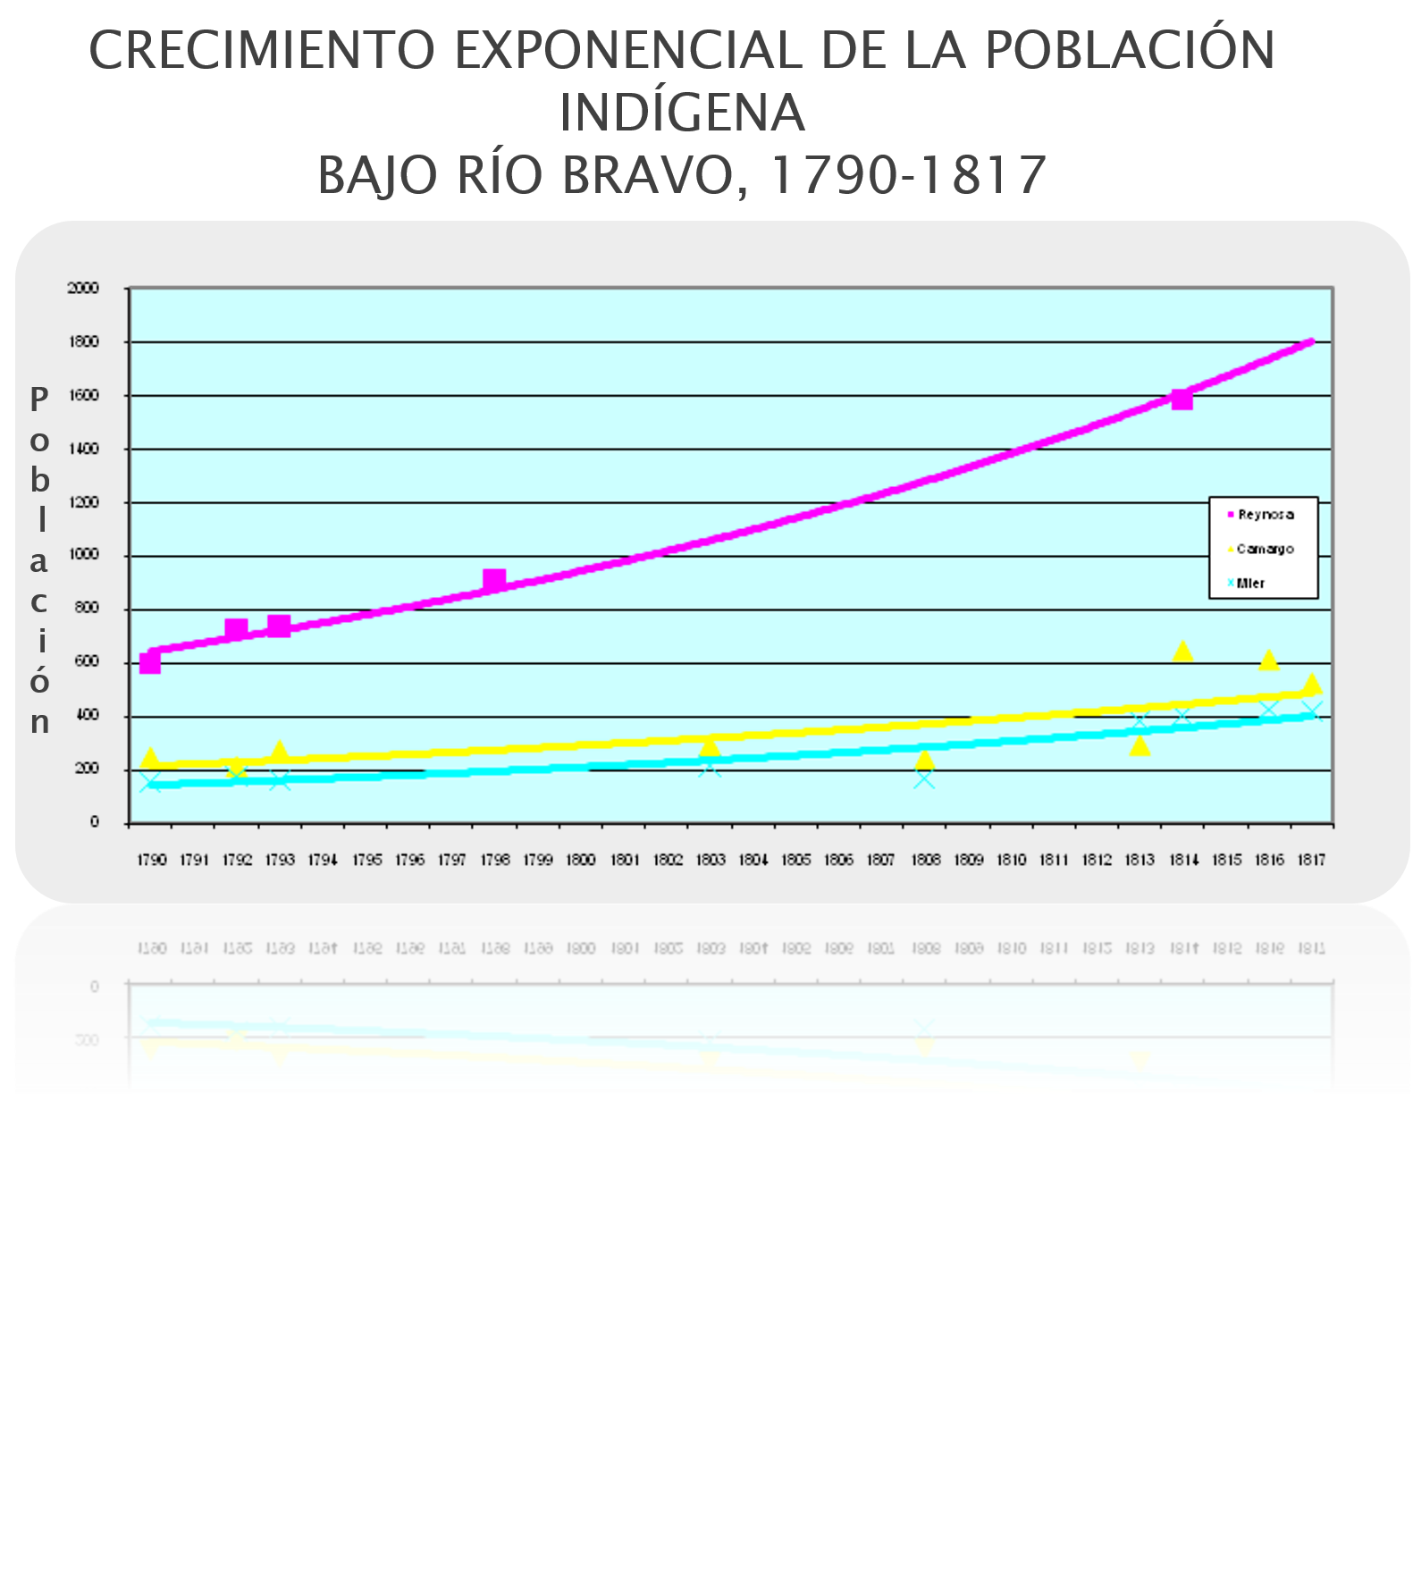
EXPONENTIAL GROWTH OF THE INDIGENOUS POPULATION
LOWER RIO GRANDE RIVER, 1790-1817
Population

Slide 30
MISSIONS AND DISTRIBUTION OF ETHNIC GROUPS ACCORDING TO THE COUNT OF SIERRA GORDA, MARCH 1798

Slide 31
RUINS (ARCHES) IN THE SAN AGUSTÍN DE LA LAREDO CAMARGO MISSION
HEADQUARTERS OF JULIÁN CANALES
(CARRIZO INDIAN) APRIL 1812

Slide 32
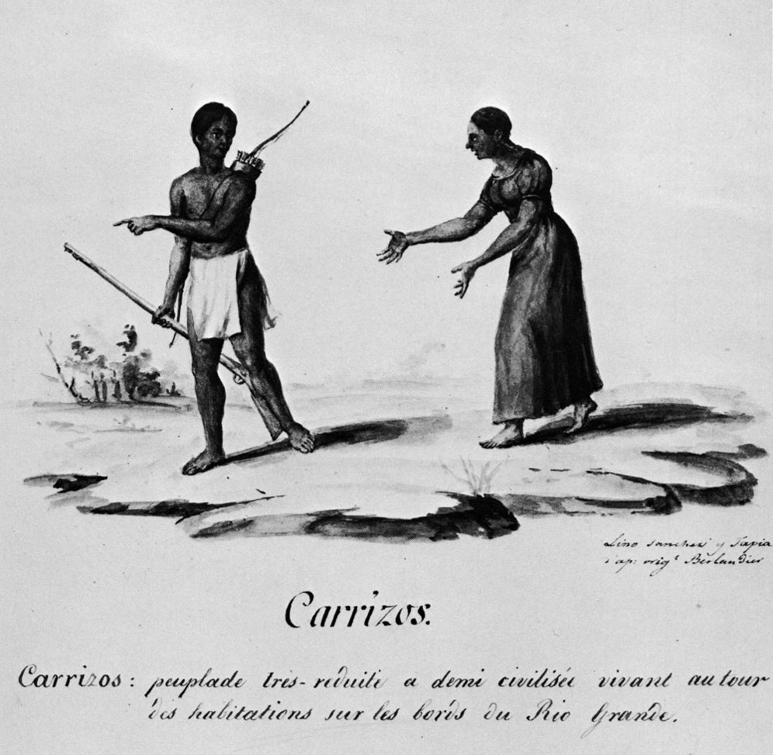

Slide 33
Table 4.
Indigenous groups from the San Joaquín del Monte de Reynosa Mission
Anda el camino Casas chiquitas Comecrudos del Río Bravo Como se llaman Cotonames Guajolotes o Cacalotes del Río Bravo 4 Malaguitas Mayapemes Mulatos Narices | Nazas Negros Pames Pelones Pintos del Río Bravo Saulapaguemes Tampacuas Tejones Zacatiles

Slide 34
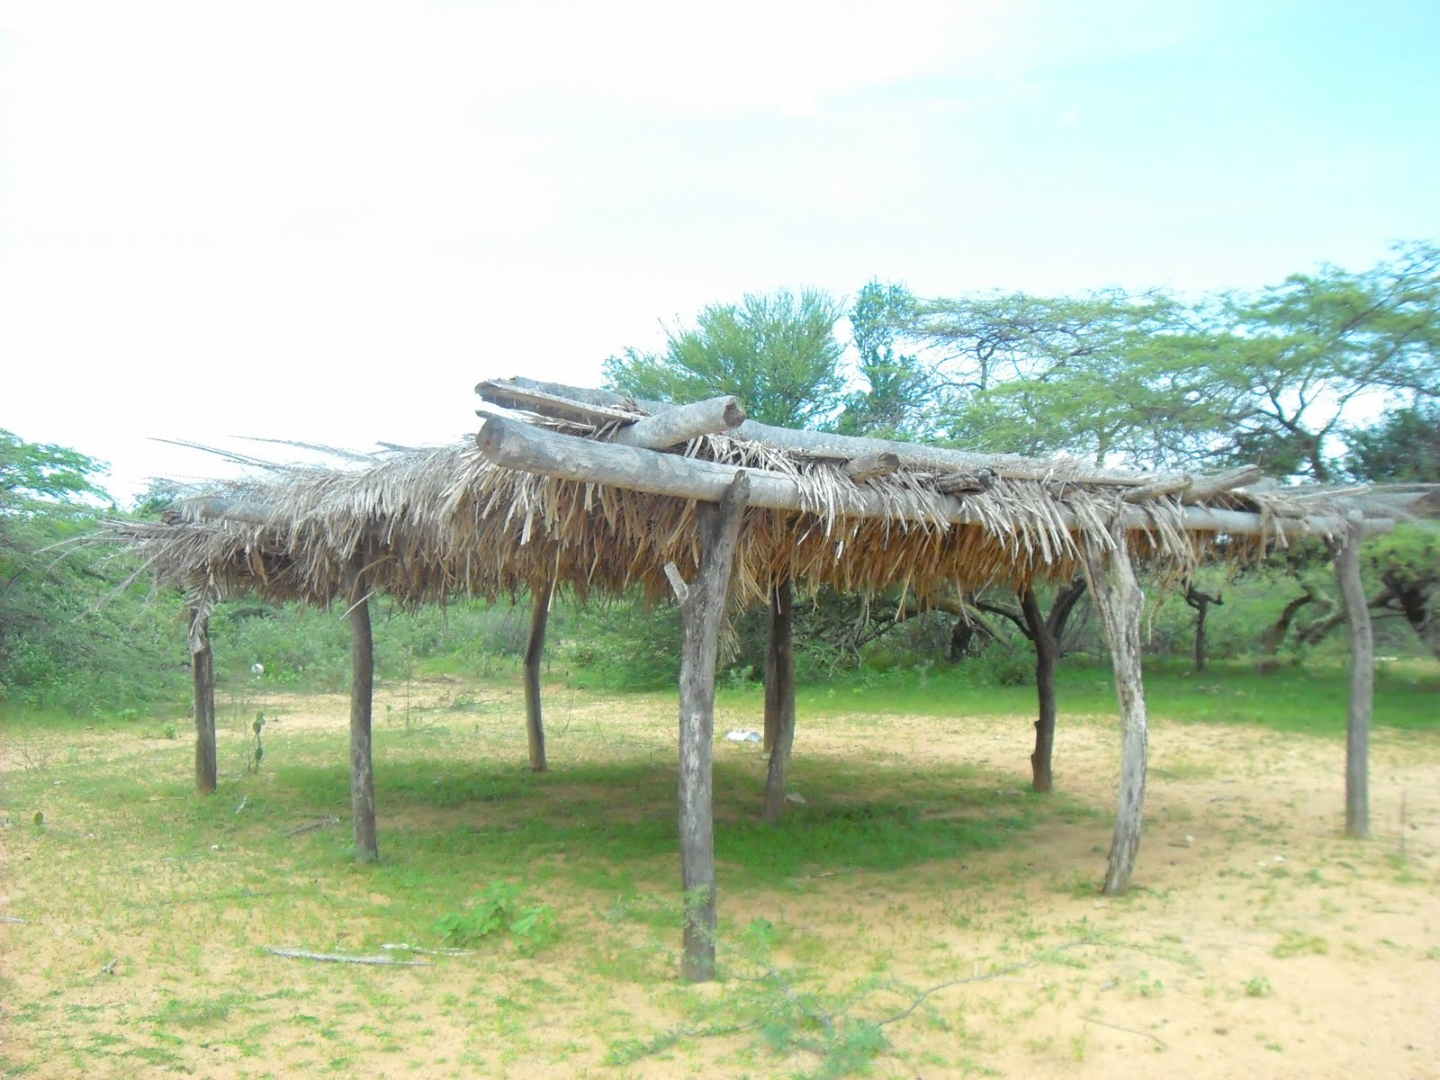

Slide 35
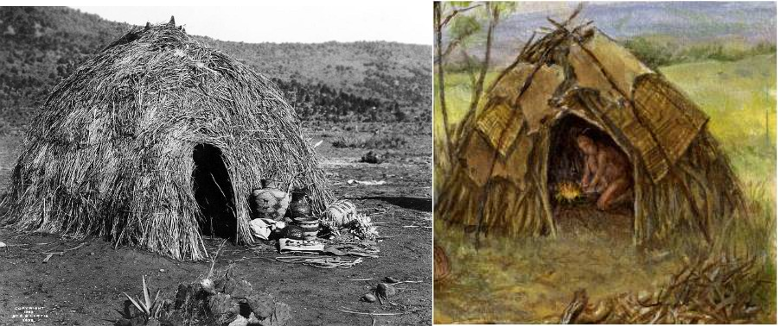

Slide 36
Table 3
Wild plants used for food
Plants | Rio Grande Delta | Lower San Fernando River | Cerralvo area
Cactus/prickly pear:
Fruit/cactus: | 1, 3 | 8, 10, 11 | 4, 5, 14
Mesquite:
Bean pod: | 1, 3 | 8 | 5
Maguey: stems | 1 | 8, 12 | 7
Garlic, onion
Bulbs | 6 | -- | --
Yucca: flower buds | -- | -- | 5
Plama: unspecified
part | 6 | -- | --
Roots: unspecified | 1, 2, 3, 6, 13 | 12 | 2
Fruit: unspecified | 2, 13 | 8 | 2, 3, 11
Herbs: unspecified | 2, 13 | 12 | 2

Slide 37
Key:
Ballí and Hinojosa [1785] op cit, pp. 1-3.
Barragán [1793ª] op cit, pp. 39-42, [1793b] op cit, pp. 344-345.
Berlandier [1980] op cit, vol 2: p. 590.
Causas Criminales [1782-1787] op cit, p. 83.
Cabeza de Vaca [1542] op cit, pp. 41ª-42b, 46ª-48; Oviedo y Valdés [1959] op cit, vol 4: pp. 305-307.
Escandón [1946] op cit, p. 85.
Kress and Hatcher [1931] op cit, p.35.
Ladrón de Guevara [1753b] op cit, p. 166.
Ladrón de Guevara [1969] op cit, p. 29.
Noticias de los Conventos [1790-1814] op cit, p. 131.
Saldívar [1943] op cit, pp. 32-33.
Serie de Documentos [1783-1800] op cit, pp. 119-121.
Sierra Gorda [1798] op cit, pp. 1-5.
Tienda de Cuervo [ 1929] op cit, pp. 411-412.

Slide 38
Table 2
Hunted animals
 | Rio Grande Delta | Lower San Fernando River | Cerralvo area
Animals
Reindeer | 1, 2, 3, 8, 9 | 6 | 7, 9
Peccary | 2 | 6 | 7
Rabits | -- | 6 | 5
Rats, mice | 3, 8 | -- | 5
Turkey | -- | 6 | --
Birds, unespecified | 4 | -- | --
Snakes | -- | -- | 5
Wild horses | 8 | -- | --
Spanish cattle | 8 | -- | --

Slide 39
Key:
“De Joseph Abitu Cantu, Apolinario Moya,” op. cit., pp. 1-28.
“Visita al Nuevo Santander,” op. cit., pp. 39-42, “Ynforme…Francisco Nepomuceno de Barragán,” op. cit., pp. 344-345.
Berlandier, Journey, op cit, vol. 1, pp. 244, 2: p. 590.
Escandón, Reconocimiento op. cit., p. 65.
Kress and Hatcher, op. cit., p. 35.
Ladrón de Guevara, op. cit., p. 29.
“Noticias de los Conventos” op. cit., pp. 68, 118, 131, 13, 152.
El gobernador del Nuevo Santander,” op. cit., pp. 1-5.
Tienda de Cuervo, “Inspección,” op. cit., pp. 375, 381, 385, 396-398, 402, 411-414, 432.

Slide 40
INDIAN IMMIGRATION INTO THE LOWER
RIO GRANDE RIVER

Slide 41
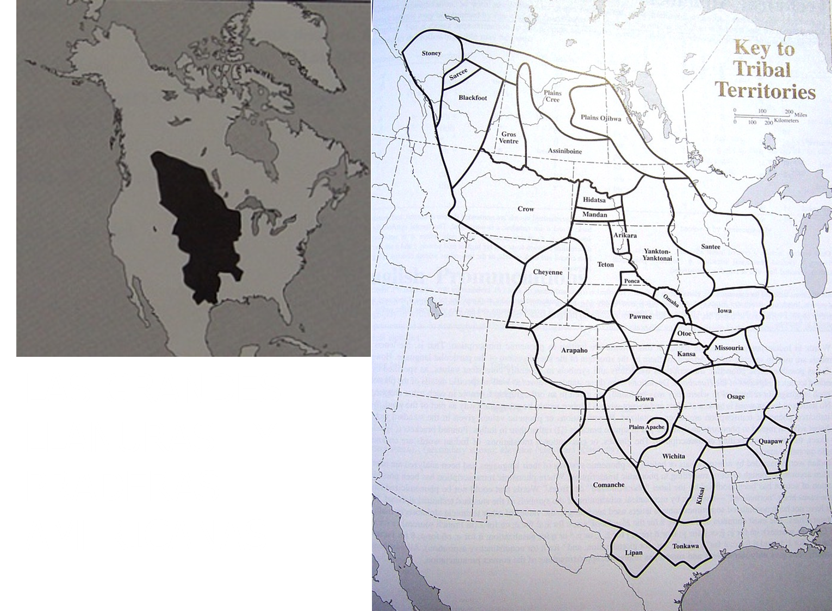

Slide 42
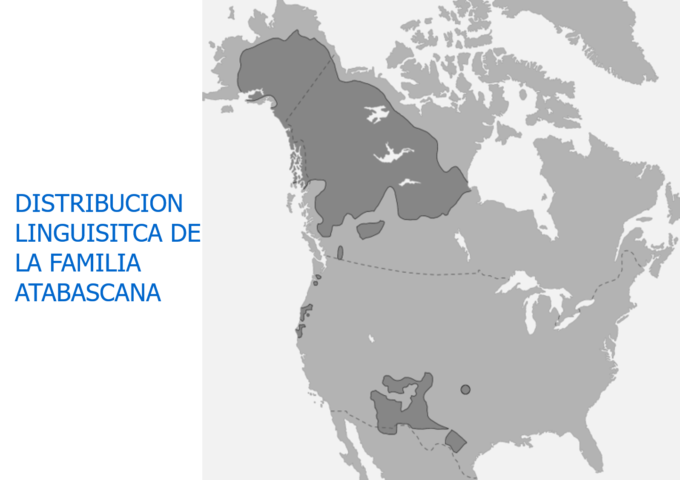
LINGUISTIC DISTRIBUTION OF THE ATABASCANA FAMILY

Slide 43
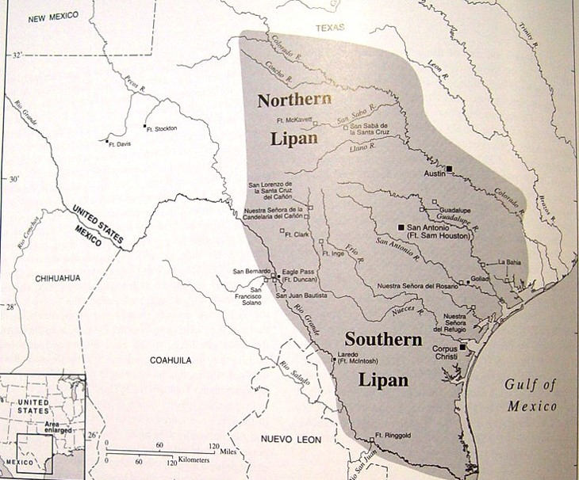

Slide 44
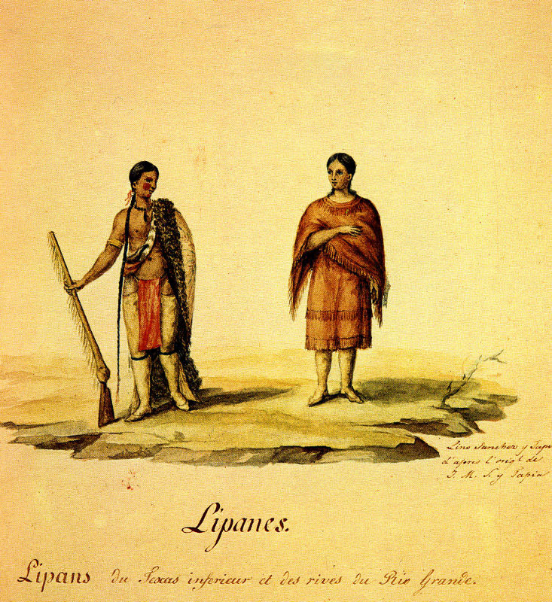

Slide 45
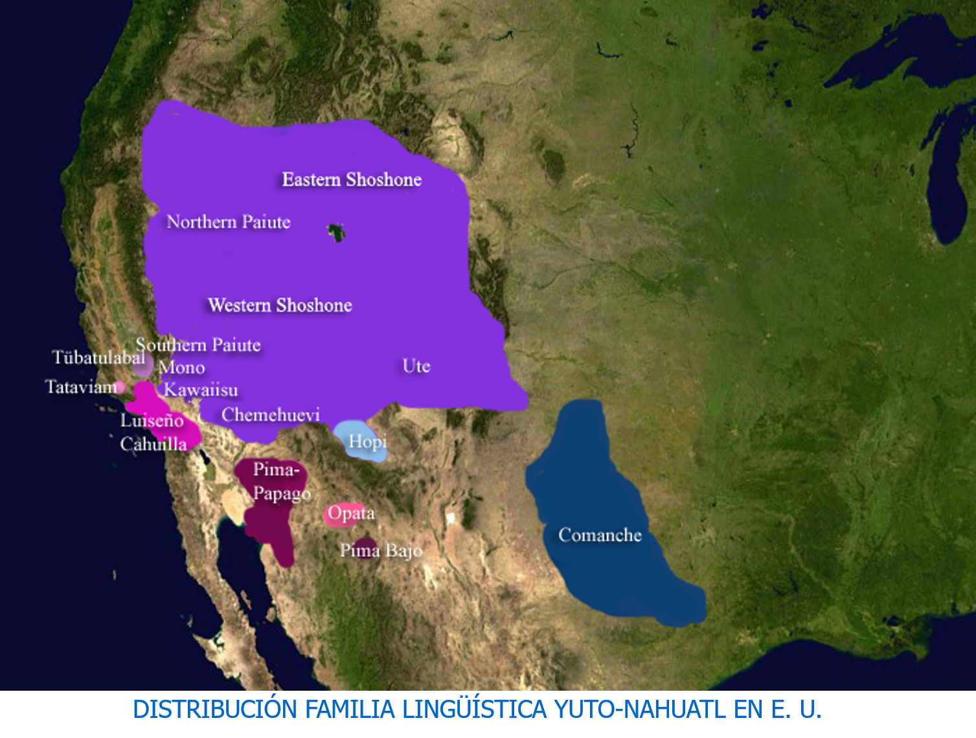
DISTRIBUTION OF THE YUTO-NAHUATL LINGUISTIC FAMILY IN THE U.S

Slide 46
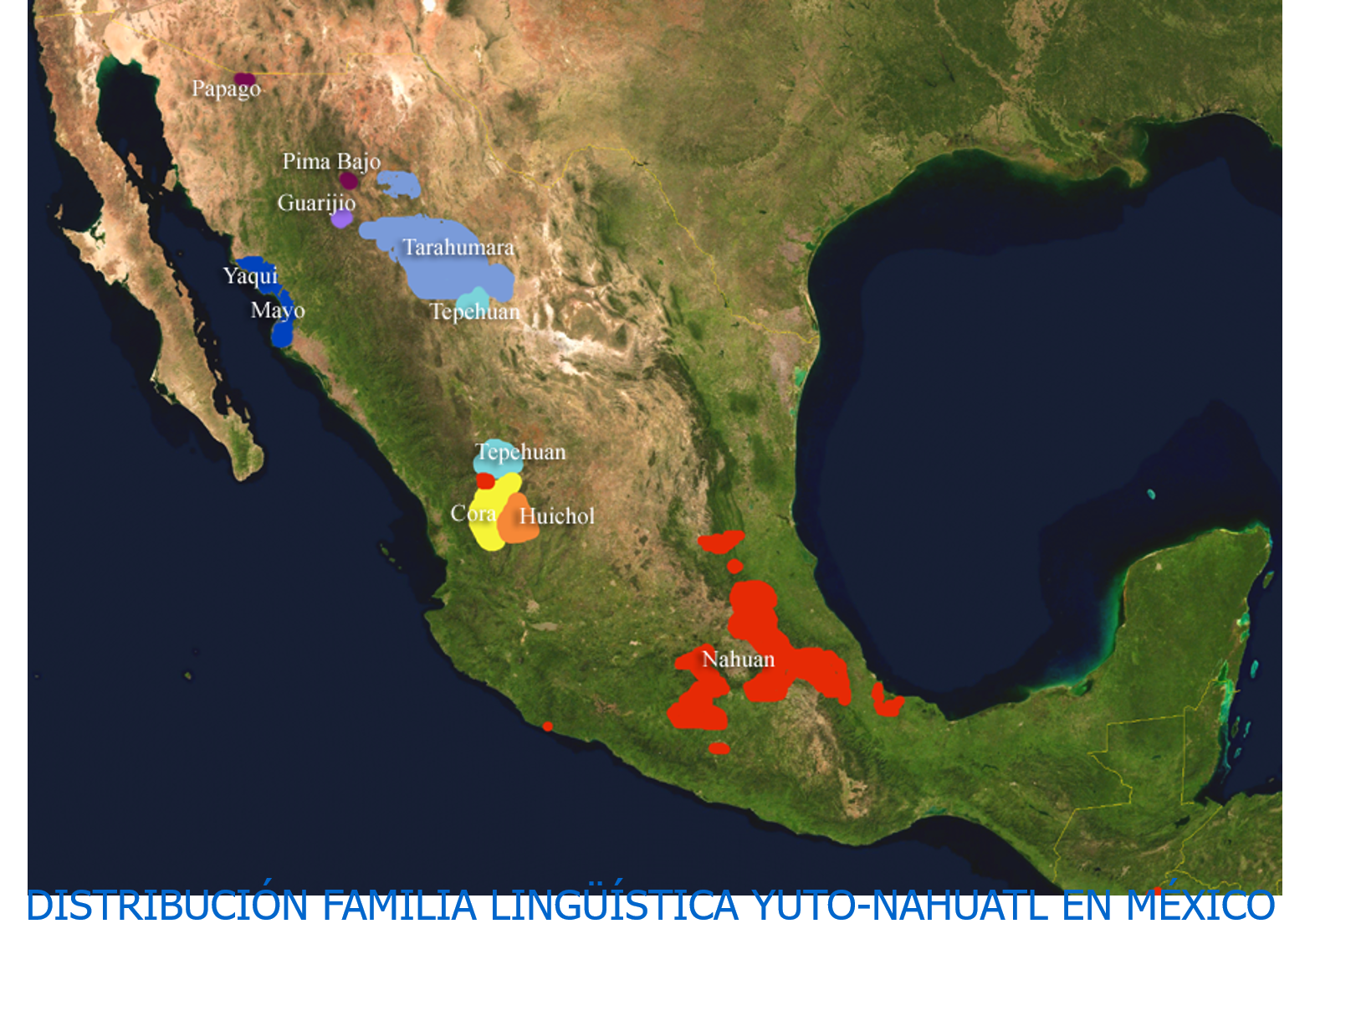
DISTRIBUTION OF THE YUTO-NAHUATL LINGUISTIC FAMILY IN THE MEXICO

Slide 47
COMANCHE TERRITORIES 18th AND 19th Century

Slide 48
