Slide 1

Assessing the Reliability, Internal Consistency, and Sensitivity of a Nutrition Knowledge Questionnaire for Four-Year-Old Pre-K Children
Wang L,¹ Cortez K,² Rodriguez B,¹ Reyes J,¹ Cisneros M,¹ Alaniz E,¹ Romero Z,¹ Salinas L,¹ Lopez-Alvarenga JC, ¹Trevino R¹
1 University of Texas Rio Grande Valley
2 Social and Health Research Center

Slide 2



Background
Assessing nutrition knowledge in four-year-olds, a developmental stage marked by limited attention spans and varying comprehension abilities, is challenging with traditional methods. A reliable test is pivotal for establishing a foundation for future health interventions.

Slide 3
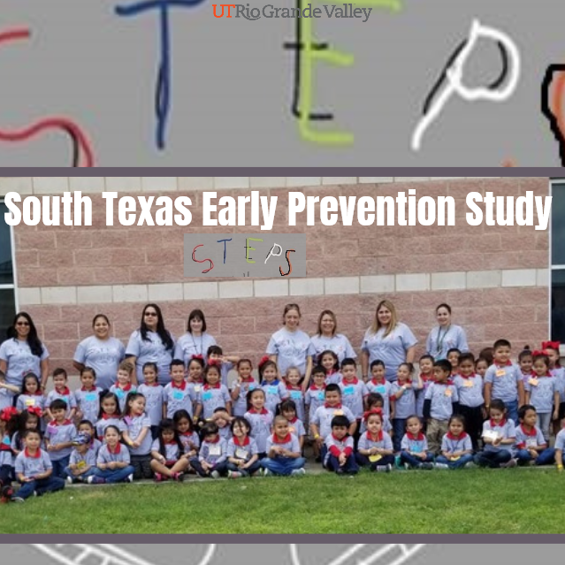
Purpose and Hypothesis
We evaluated a 13-question nutrition and healthy habits test in Pre-K4 children to assess reliability and sensitivity to detect differences. Null hypothesis was used.

Slide 4
Methods and Results
Calculations included Cronbach's alpha, kappa coefficient, McNemar analysis by item, and Bland-Altman plots for test-retest differences. Mixed model regression assessed the questionnaire's sensitivity by sex and association with age. Item response theory (IRT) models were employed, generating latent abilities for students and individual scores using Bayesian modeling.

Slide 5
Descriptive analysis and initial exploration
Plots of loading vectors, whose components are the loading magnitudes. There is a correspondence with the tetrachoric correlation matrix.

Slide 6
Item Response prediction.
Two parameter item response was used to modulate difficulty and discrimination for each question
Dotplot of theta adjusted by age and nested on schools and districts. Highest values represent better skills to answer the test. F: Females, M: Males, Eng: Test in English language, Sp: Test in Spanish language. There was no multiplicative interaction (sex language, p=0.096).

Slide 7
Item Response prediction.
Scatterplot of scores of test re-test. The continuous line shows the absolute agreement and the discontinuous line the fitted line for regression
Scatterplot of predicted theta of test re-test. The continuous line shows the absolute agreement and the discontinuous line the fitted line for regression
February, 2024

Slide 8
Item Response prediction.

Slide 9

Conclusions
The Pre-K questionnaire exhibited consistency and validity. This evaluation is crucial for appraising the effectiveness of educational programs, fostering an improved understanding of nutrition, and promoting healthier dietary habits in young children.

Slide 10
Selective References
A tutorial on sensitivity analyses in clinical trials: the what, why, when and how. (2013). BMC Medical Research Methodology.
Bernstein, L., Bellorado, D., & Bruvold, W.H. (1986). Evaluation of a heart health education curriculum for preschoolers, parents, and teachers. Health education, 17 3, 14-7.
InformatioTanaka, Y., Castaño-Tostado, E., & Odaka, Y. (1989). Sensitivity Analysis in Factor Analysis: Methods and Software. SpringerLink.
Kohler U, Luniak MM. Data inspection using biplots. Stata Journal 2005. ; 5: 208–223.]
Seitz, H. H., Parker, J. C., Hanna, H. L., & Hooge, G. C. (2021). Evaluation of a Health Education Intervention for Rural Preschool and Kindergarten Children in the Southeastern United States: A Cluster Randomized Trial. Journal of Human Sciences and Extension, 9(1), 4. DOI: https://doi.org/10.54718/OTUV4979

Slide 11

Thank You
lin.wang@utrgv.edu
on behalf of the STEPS Team

